Slide 1
Team 501: Powder Recovery for Metal Additive Manufacturing
Arlan Ohrt
Kevin Richter
Vincent Giannetti
Noah Tipton
Joshua Dorfman
April 16th, 2020

Slide 2
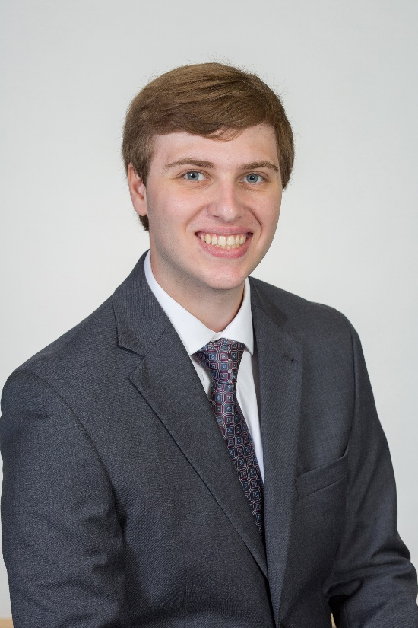
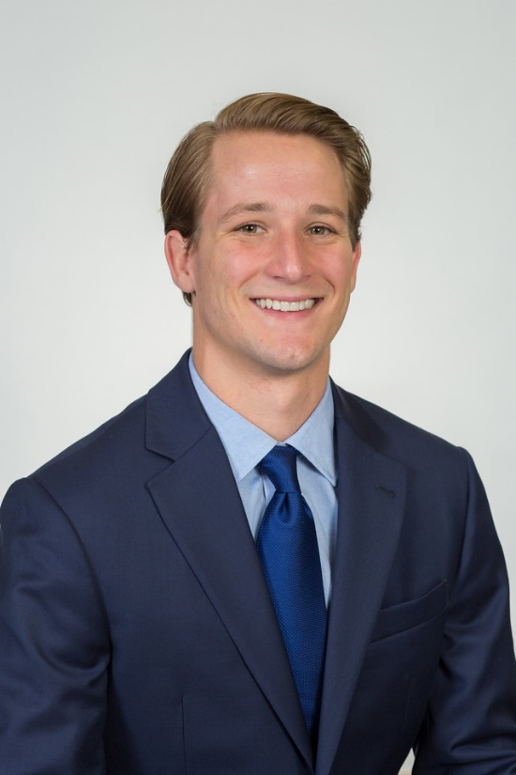
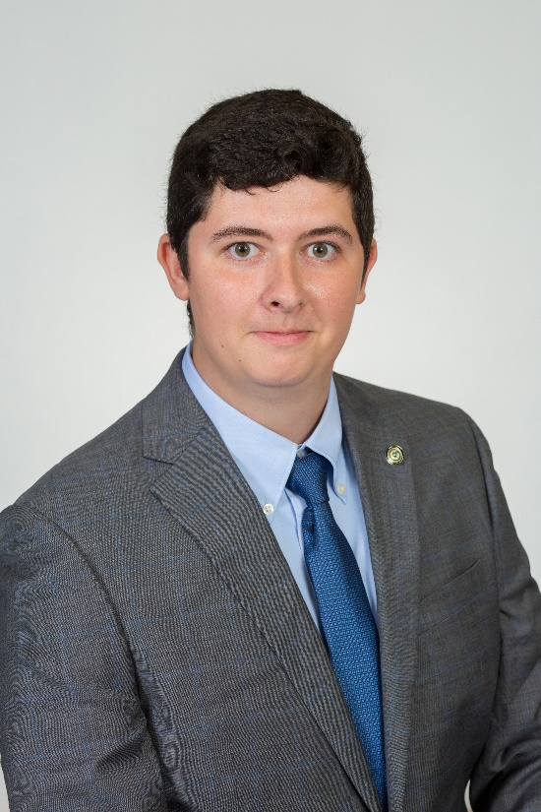
Team Introductions
Vincent Giannetti
Noah Tipton
Kevin Richter
Arlan Ohrt
Joshua Dorfman
Manufacturing
Engineer
Design
Engineer
Field
Engineer
Project/Systems Engineer
Field
Engineer

Slide 3
Sponsor – Air Force Research Labs (AFRL)
AFRL/RWMW – Ordnance Division, Damage Mechanisms Branch (Eglin Air Force Base)
A global leader in advancing weapons science and technology
Specific Contact - Dr. Philip Flater
Lead for the metal additive manufacturing lab at AFRL/RWMW
Vincent Giannetti

Slide 4
Project Description
The objective of this project is to design a device which increases the amount of recovered steel powder in a metal additive manufacturing process. This device should be compatible with existing hardware and processes while ensuring the safety of the operators.
Vincent Giannetti

Slide 5
Project Key Goals and Customer Needs
The objective of this project is to design a device which increases the amount of recovered steel powder in a metal additive manufacturing process. This device should be compatible with existing hardware and processes while ensuring the safety of the operators.
Increase amount of recovered steel powder
Be compatible with existing hardware and processes
Ensure operator’s safety
Vincent Giannetti

Slide 6
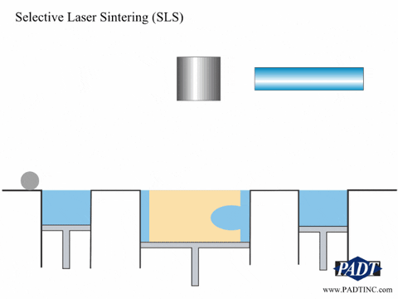
Project Background – Metal Additive Manufacturing
Laser Powder Bed Fusion (LPBF):
Powder Distributed in an Even Layer
Laser Traces Layer Path to “Fuse” Material Together
This process results in a large amount of “unfused” powder. This powder should be recycled.
Vincent Giannetti

Slide 7
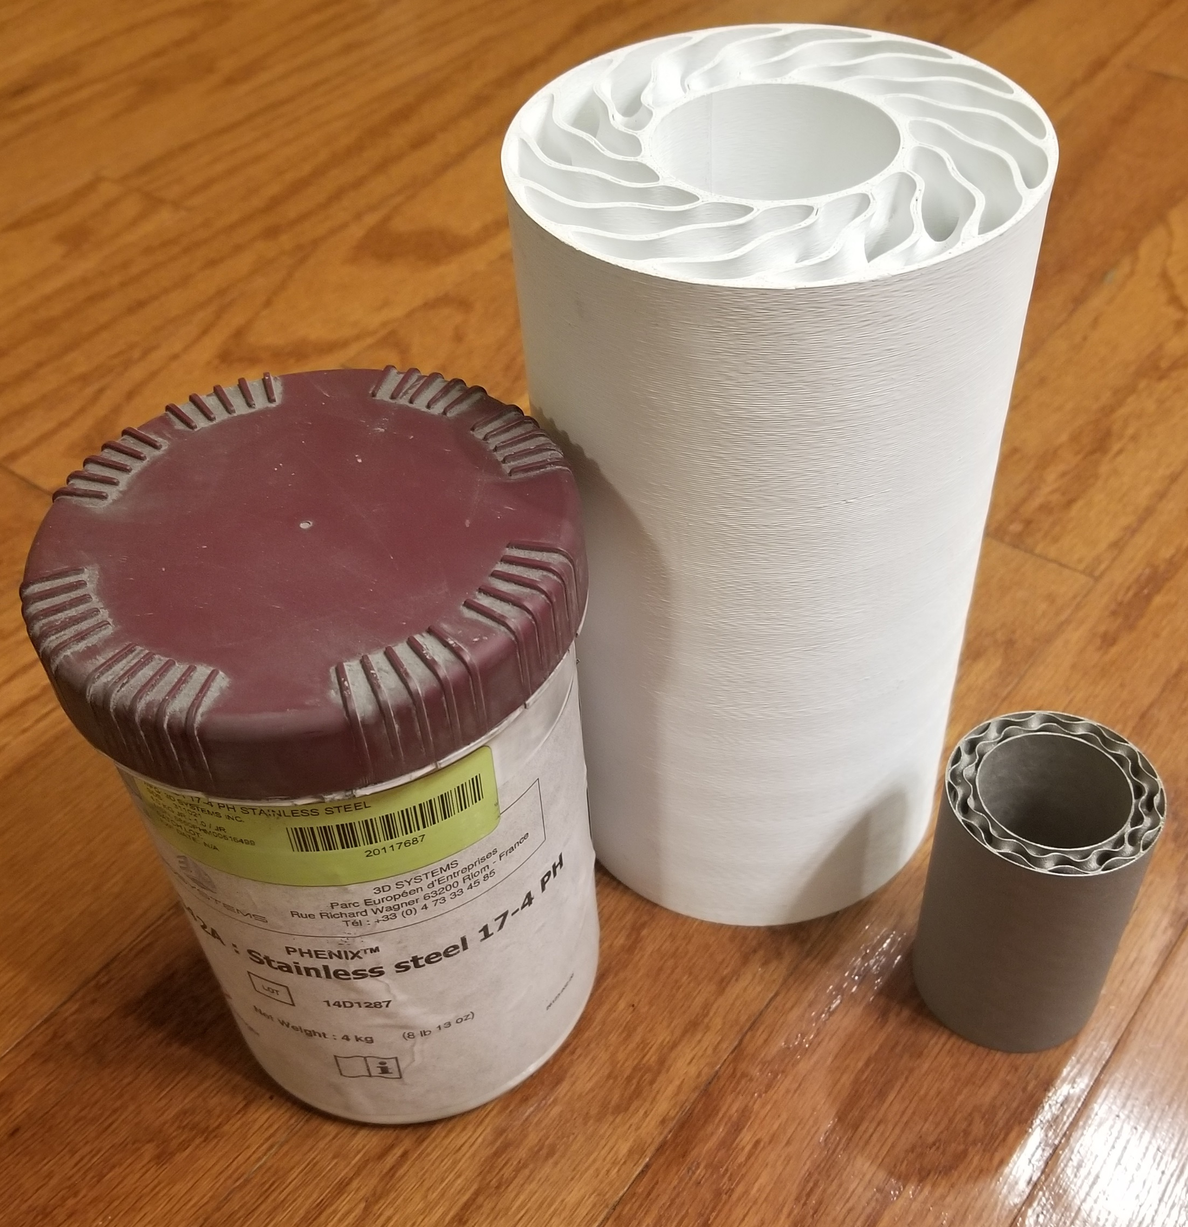
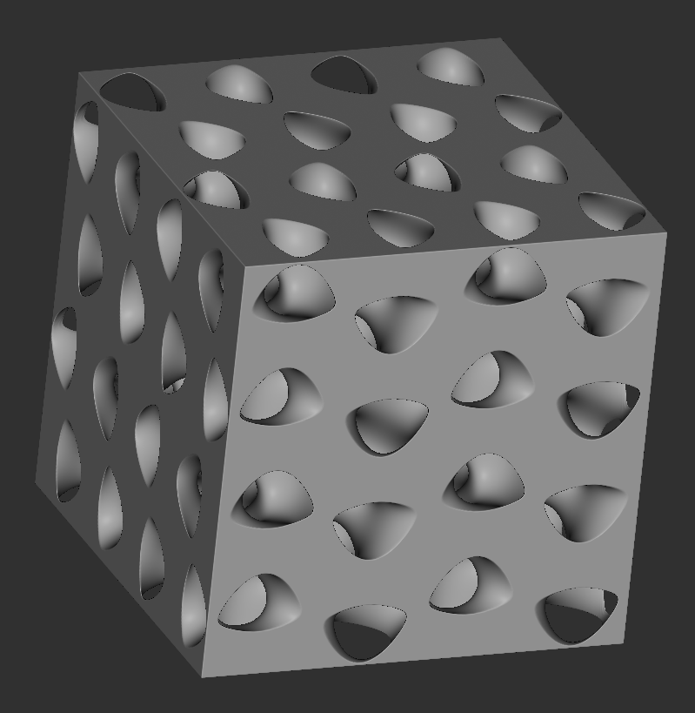
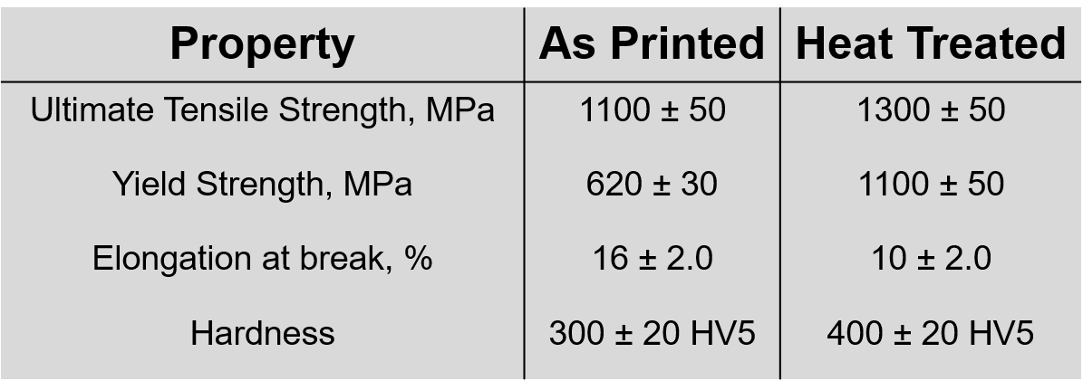
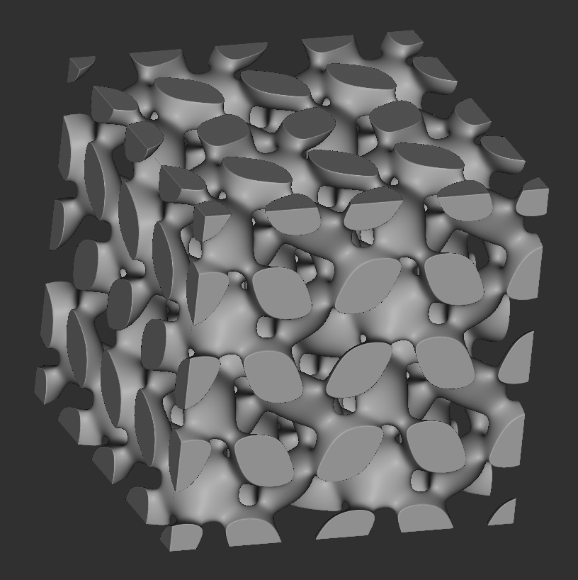
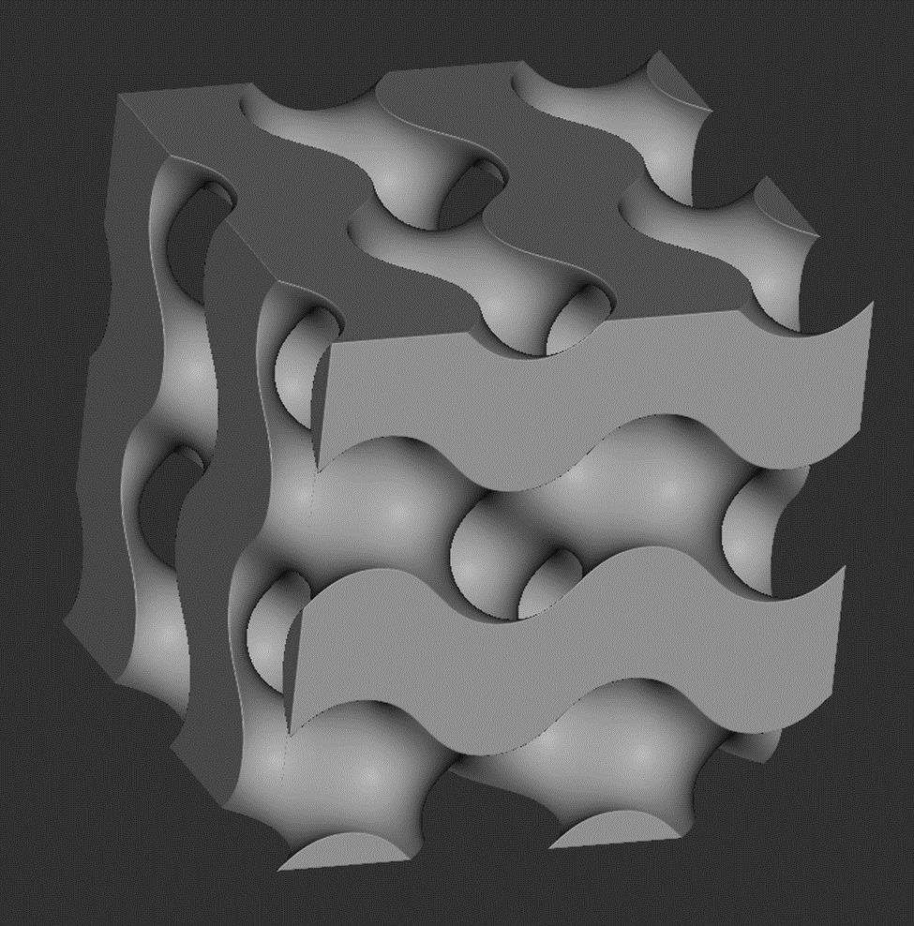
Project Background – The Metal Used
17– 4PH Stainless Steel: 17% Chromium, 4% Nickel, Precipitation Hardening
General Info:
Purchased from company that makes the printer
Particle Size: 10 – 15 μm (Paper thickness is ~ 100 μm)
Martensitic Steel (Magnetic)
Vincent Giannetti

Slide 8
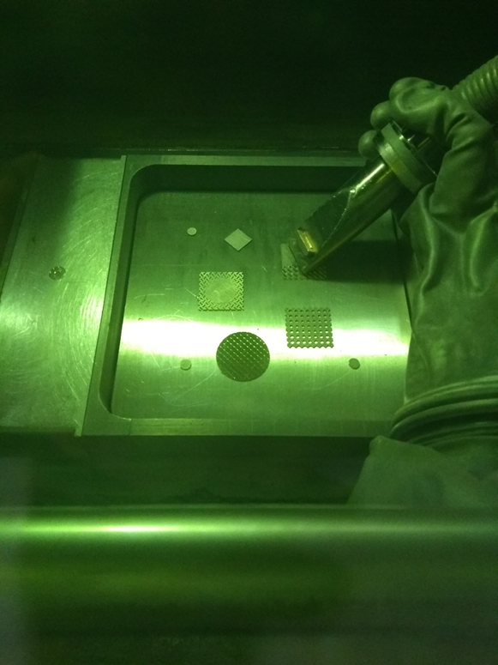
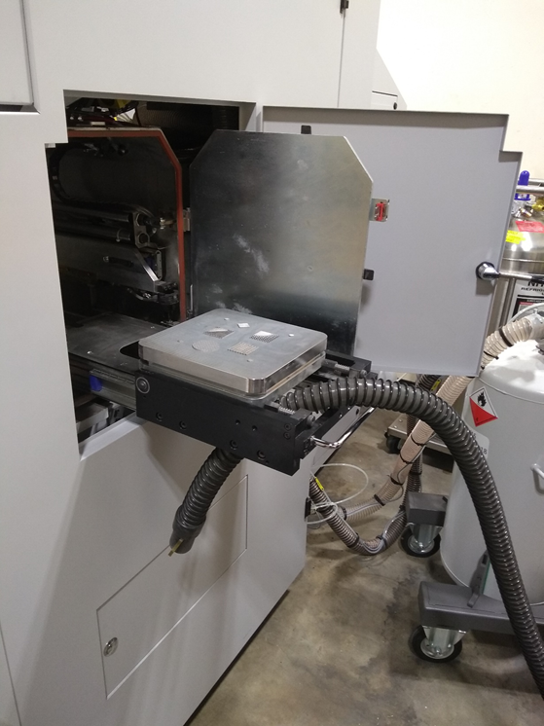
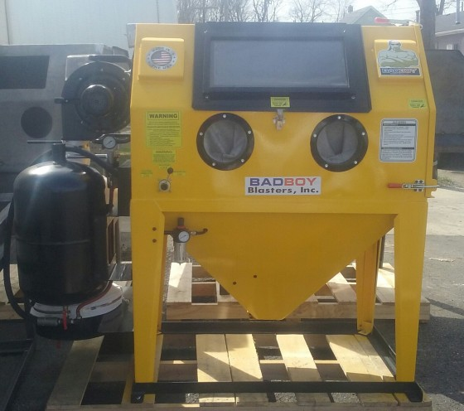
Project Background – Powder Recovery Stages
“Built In Stage”
“Wet Vac Stage”
“Air Powered Stage”
Vincent Giannetti

Slide 9
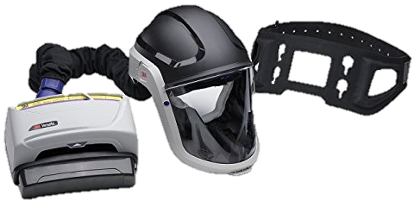
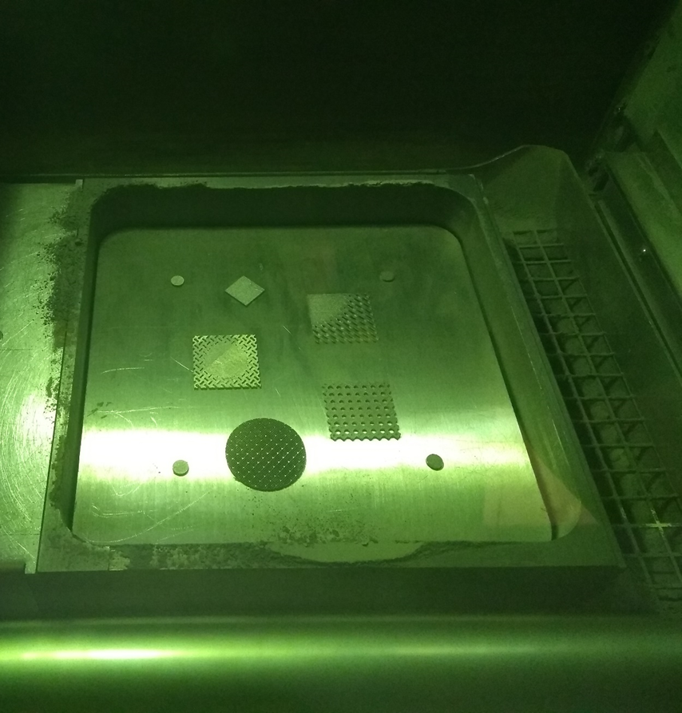
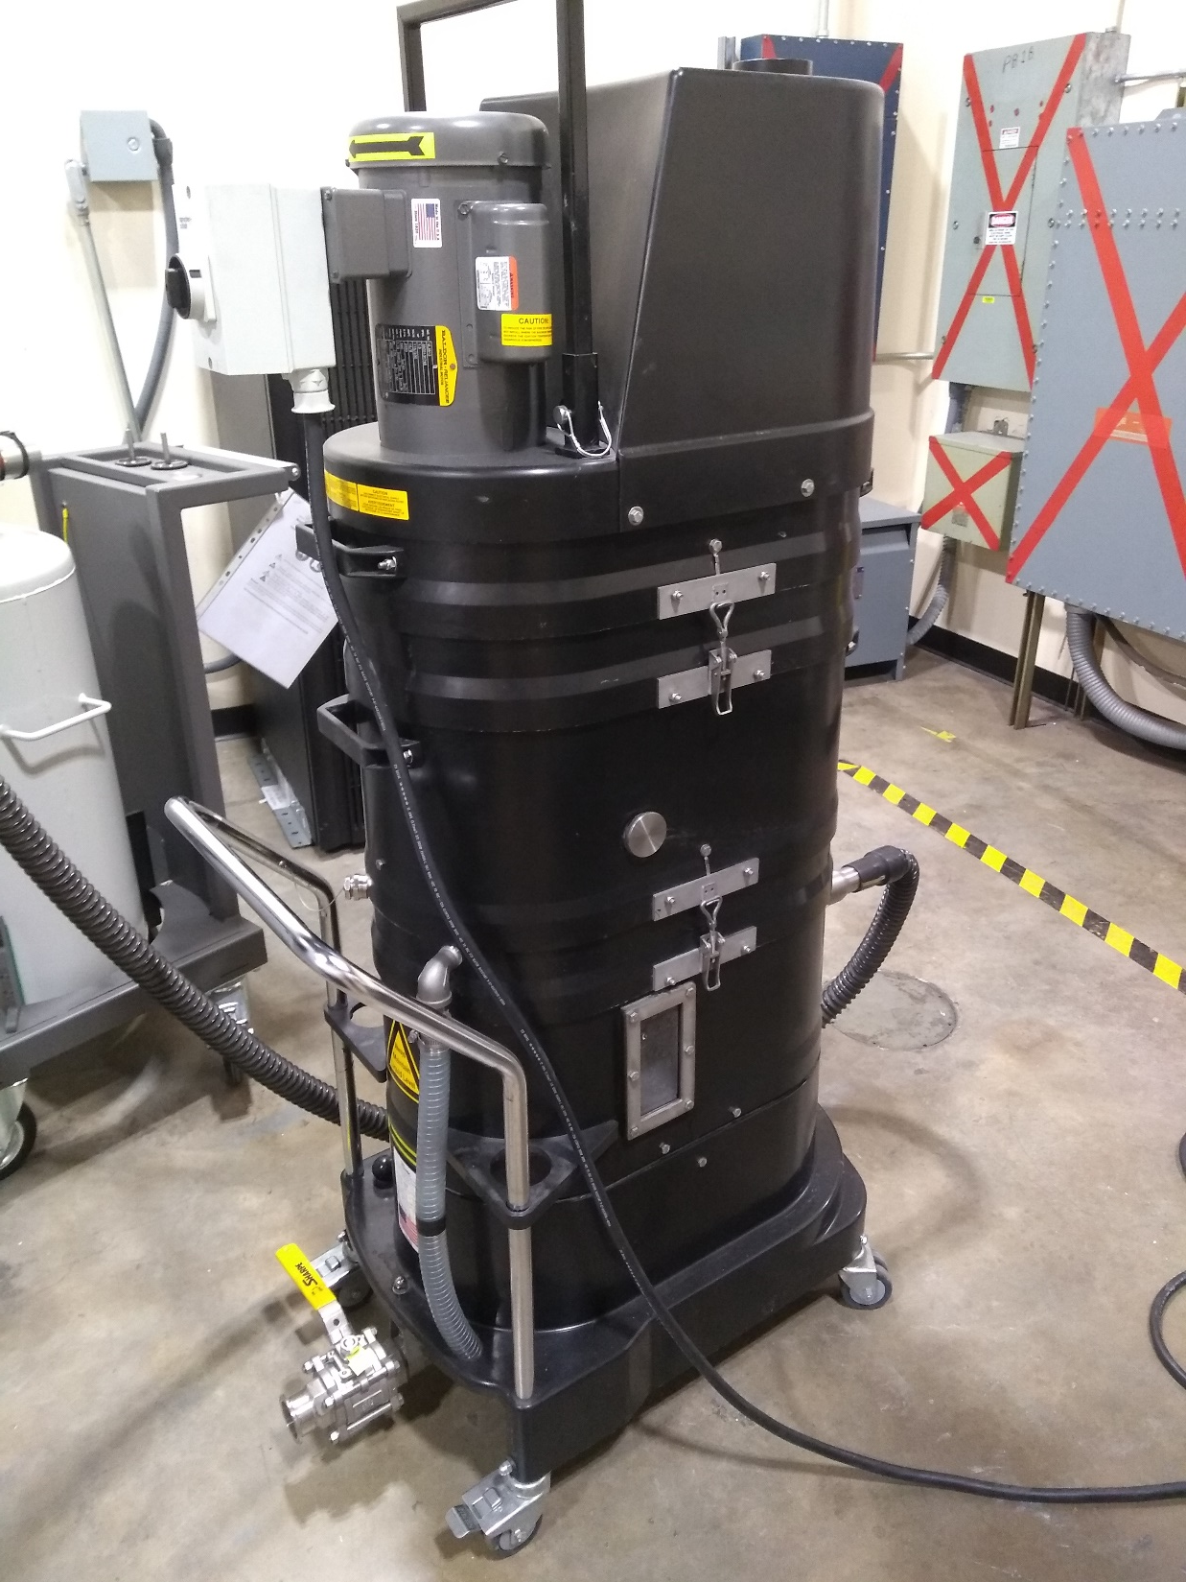
Project Background – Powder Recovery Stages
Stage 2 – “Wet Vac Stage”
Removing the part
Pass the build plate out
Operation
Use powered air purifying respirator (PAPR)
Open door and remove part
Use Ruwac NA35 Immersion Vacuum
Stage 1 – “Built In Stage”
Built in recovery system
Vacuum
Overflow Reservoir
Operation
Sealed chamber
Glove to operate vacuum
No Powder Recovery
Substantial Powder Recovery
Vincent Giannetti

Slide 10
Project Background – Powder Recovery Stages
Stage 1 – “Built In Stage”
Built in recovery system
Vacuum
Overflow Reservoir
Operation
Sealed chamber
Glove to operate vacuum
Stage 2 – “Wet Vac Stage”
Removing the part
Pass the build plate out
Operation
Use powered air purifying respirator (PAPR)
Open door and remove part
Use Ruwac NA35 Immersion Vacuum
Stage 3 – “Air Powered Stage”
Sandblasting cabinet
Operation
Place part inside the enclosure
Use compressed air to remove residual powder
Substantial Powder Recovery
No Powder Recovery
No Powder Recovery
Vincent Giannetti

Slide 11
Project Background – Powder Recovery Stages
Stage 3 – “Air Powered Stage”
Sandblasting cabinet
Operation
Place part inside the enclosure
Use compressed air to remove residual powder
Stage 2 – “Wet Vac Stage”
Removing the part
Pass the build plate out
Operation
Use powered air purifying respirator (PAPR)
Open door and remove part
Use Ruwac NA35 Immersion Vacuum
No Powder Recovery
No Powder Recovery
Vincent Giannetti

Slide 12
“Our System”
Substantial Powder Recovery
Project Background – Powder Recovery Stages
Substantial Powder Recovery
No Powder Recovery
No Powder Recovery
“Built In Stage”
“Wet Vac Stage”
“Air Powered Stage”
Vincent Giannetti

Slide 13
Project Background – Powder Recovery Stages
“Our System”
Substantial Powder Recovery
Substantial Powder Recovery
No Powder Recovery
No Powder Recovery
“Built In Stage”
“Wet Vac Stage”
“Air Powered Stage”
Vincent Giannetti

Slide 14
Targets are necessary to contain and direct the project.
We will do various “Target Checks” to show design reasoning.
Targets and Design
Hold the part in the area
Separate powder from the part
Transports powder to a container
Isolate the powder from user
Prevents powder contamination
Function
Greater than 0 grams of separated powder in container
Pass Bioenvironmental Engineering Flight (BEF) air test
Passes through 75 μm mesh
Build volume: 250 x 250 x 300 mm
Over-estimated weight: 356 N
Target
Impossible to be more specific because of large variation in printed parts.
Noah Tipton

Slide 15
Targets
Targets are necessary to contain and direct the project.
We will do various “Target Checks” to show design reasoning.
Separate powder from the part
Transports powder to a container
Hold the part in the area
Isolate the powder from user
Prevents powder contamination
Function
Greater than 0 grams of separated powder in container
Pass Bioenvironmental Engineering Flight (BEF) air test
Passes through 75 μm mesh
Build volume: 250 x 250 x 300 mm
Over-estimated weight: 356 N
Target
Impossible to be more specific because of large variation in printed parts.
Noah Tipton

Slide 16
New System
Build Plate and Part
Fasteners
Vibrator
Noah Tipton

Slide 17
New System – Structural Analysis
σ_{Max}* ≈ 315 psi
σ_{y} ≈ 40,000 psi
τ_{Max} ≈ 157 psi
τ_{Fail} ≈ τ_{Tresca} ≈ 20,000 psi
σ_{Max}*≈ 300 psi
σ_{y} ≈ 47,000 psi
σ_{Max} *≈ 915 psi
σ_{y} ≈ 40,000 psi
* CREO Von Mises
Noah Tipton

Slide 18
σ_{Max}* ≈ 315 psi
σ_{y} ≈ 40,000 psi
σ_{Max} *≈ 915 psi
σ_{y} ≈ 40,000 psi
New System – Structural Analysis
τ_{Max} ≈ 157 psi
τ_{Fail} ≈ τ_{Tresca} ≈ 20,000 psi
Target Check
Build volume: 250 x 250 x 300 mm
Over-estimated weight: 356 N
σ_{Max}*≈ 300 psi
σ_{y} ≈ 47,000 psi
* CREO Von Mises
Noah Tipton

Slide 19
New System – Structural Analysis
τ_{Max} ≈ 157 psi
τ_{Fail} ≈ τ_{Tresca} ≈ 20,000 psi
Target Check
Build volume: 250 x 250 x 300 mm
Over-estimated weight: 356 N
σ_{Max}*≈ 300 psi
σ_{y} ≈ 47,000 psi
* CREO Von Mises
Noah Tipton
What About Powder Containment?

Slide 20
New System
What About Powder Containment?
Noah Tipton

Slide 21
New System
Barrier Needed to Control Powder
What About Powder Containment?
Noah Tipton

Slide 22
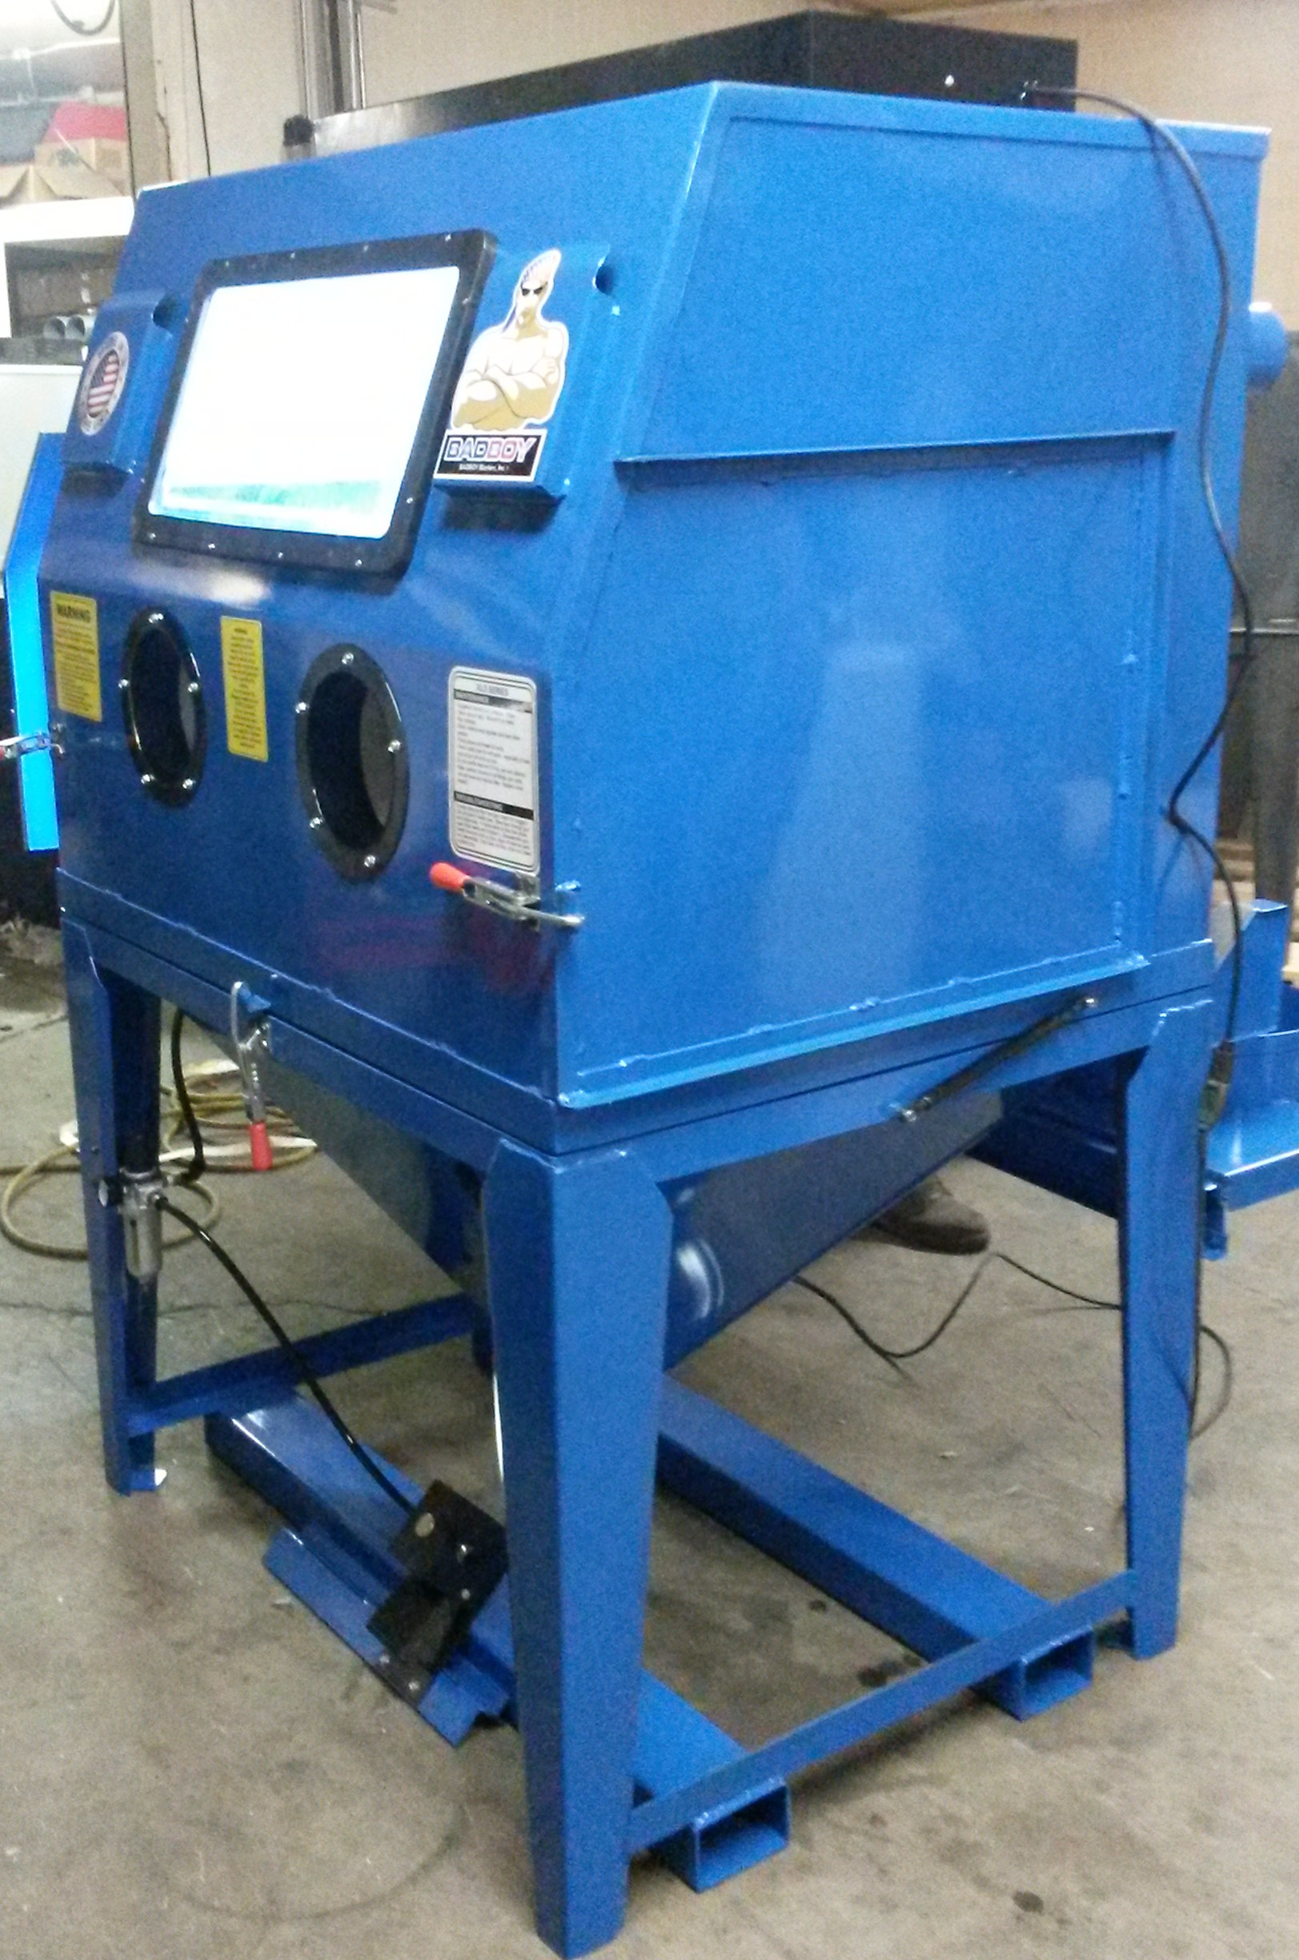
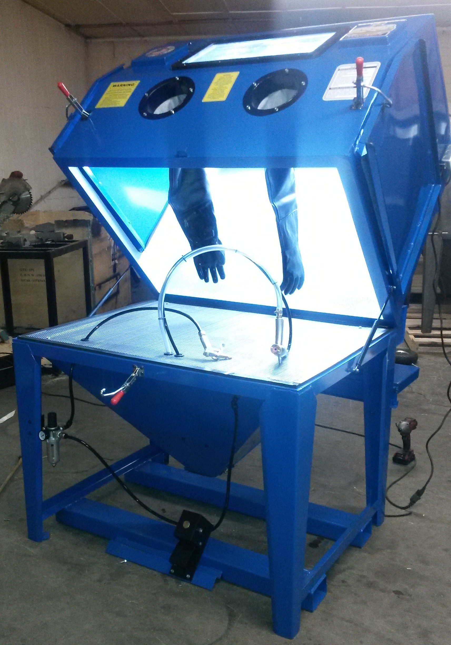
BADBOY Blaster
Clamshell Design
Fits Design Well
Industrial Quality
Chosen Barrier and Operation
Kevin Richter

Slide 23
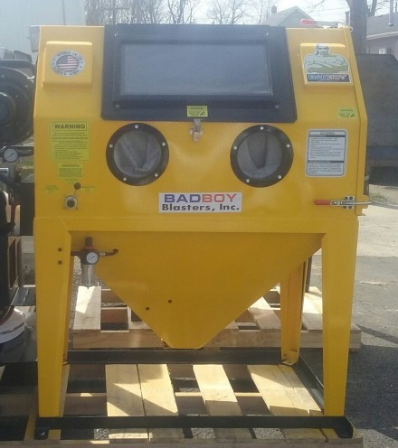
Chosen Barrier
BADBOY Blaster
Clamshell Design
Fits Design Well
Industrial Quality
AFRL is Familiar with BADBOY’s Quality
Kevin Richter

Slide 24
Chosen Barrier
BADBOY Blaster
Clamshell Design
Fits Design Well
Industrial Quality
Target Check
Pass Bioenvironmental Engineering Flight (BEF) air test.
AFRL is Familiar with BADBOY’s Quality
Kevin Richter

Slide 25
Chosen Barrier
Target Check
Pass Bioenvironmental Engineering Flight (BEF) air test.
AFRL is Familiar with BADBOY’s Quality
Kevin Richter

Slide 26
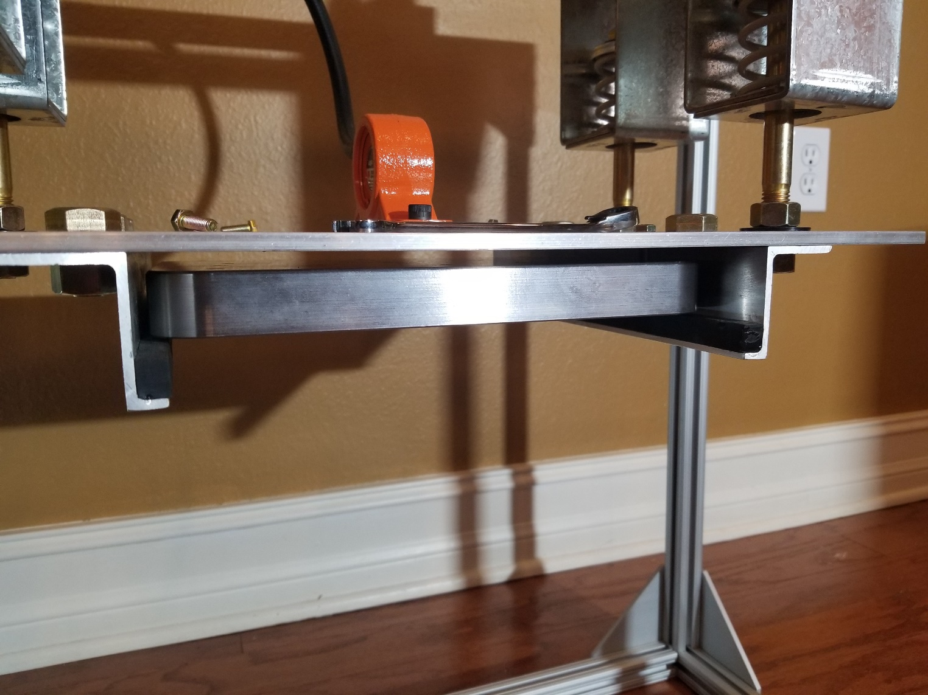
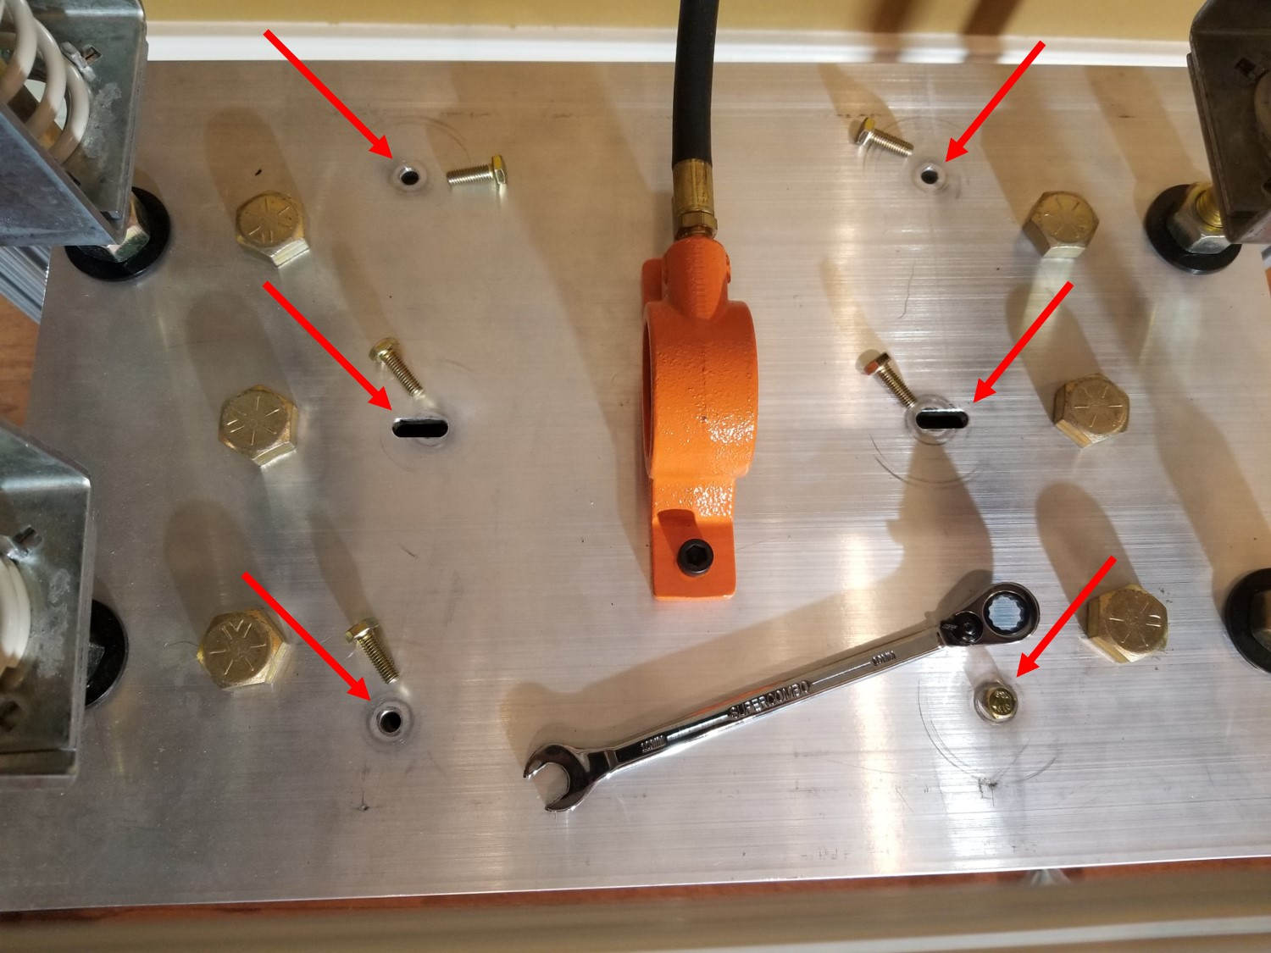
Design Operation
Align threaded holes on build plate with holes shown and fasten.
Open blasting cabinet and slide build plate in upside down.
Kevin Richter

Slide 27
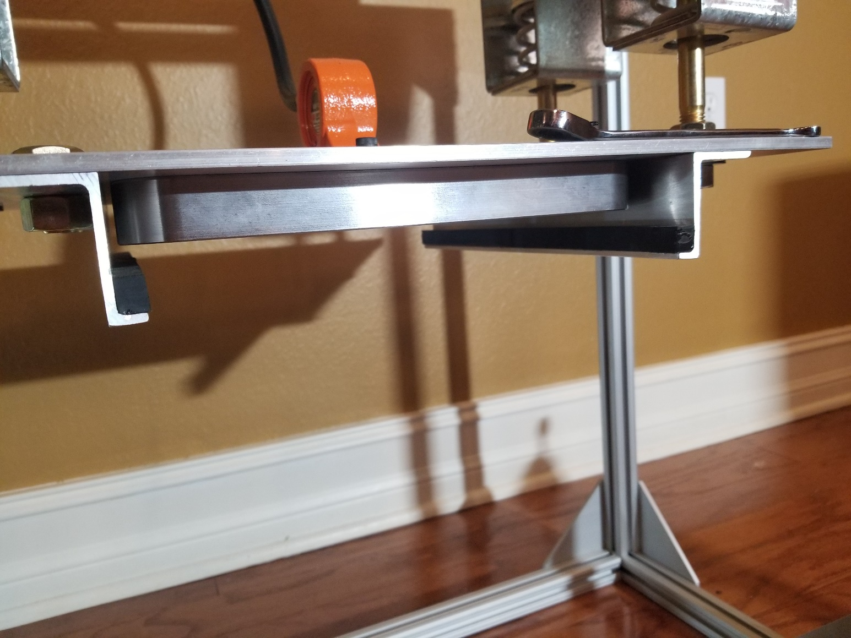
Design Operation
Noting that the build plate is fully lifted and secured, close the blasting cabinet.
Align threaded holes on build plate with holes shown and fasten.
Kevin Richter
Open blasting cabinet and slide build plate in upside down.

Slide 28
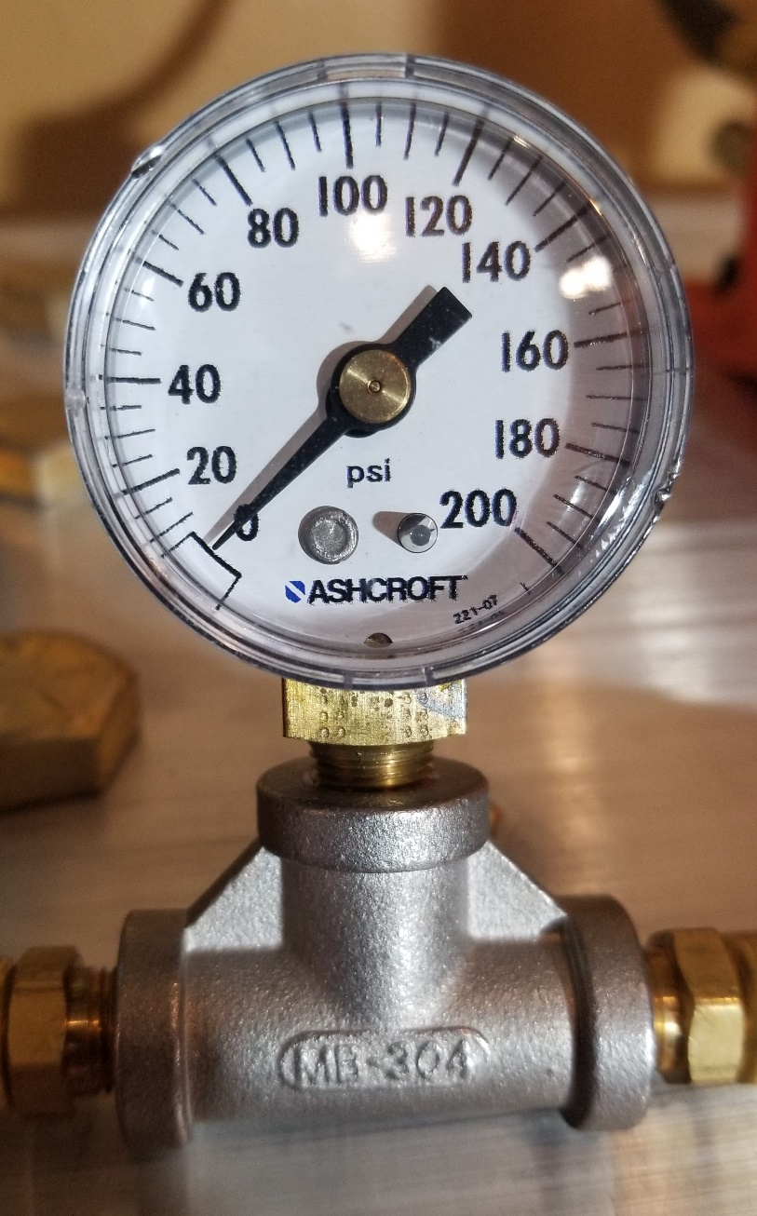
Design Operation
Raise the tool air pressure until the in-line gauge reads the desired pressure.
Noting that the build plate is fully lifted and secured, close the blasting cabinet.
Align threaded holes on build plate with holes shown and fasten.

Slide 29
Design Operation
Raise the tool air pressure until the in-line gauge reads the desired pressure.
Kevin Richter
Noting that the build plate is fully lifted and secured, close the blasting cabinet.

Slide 30
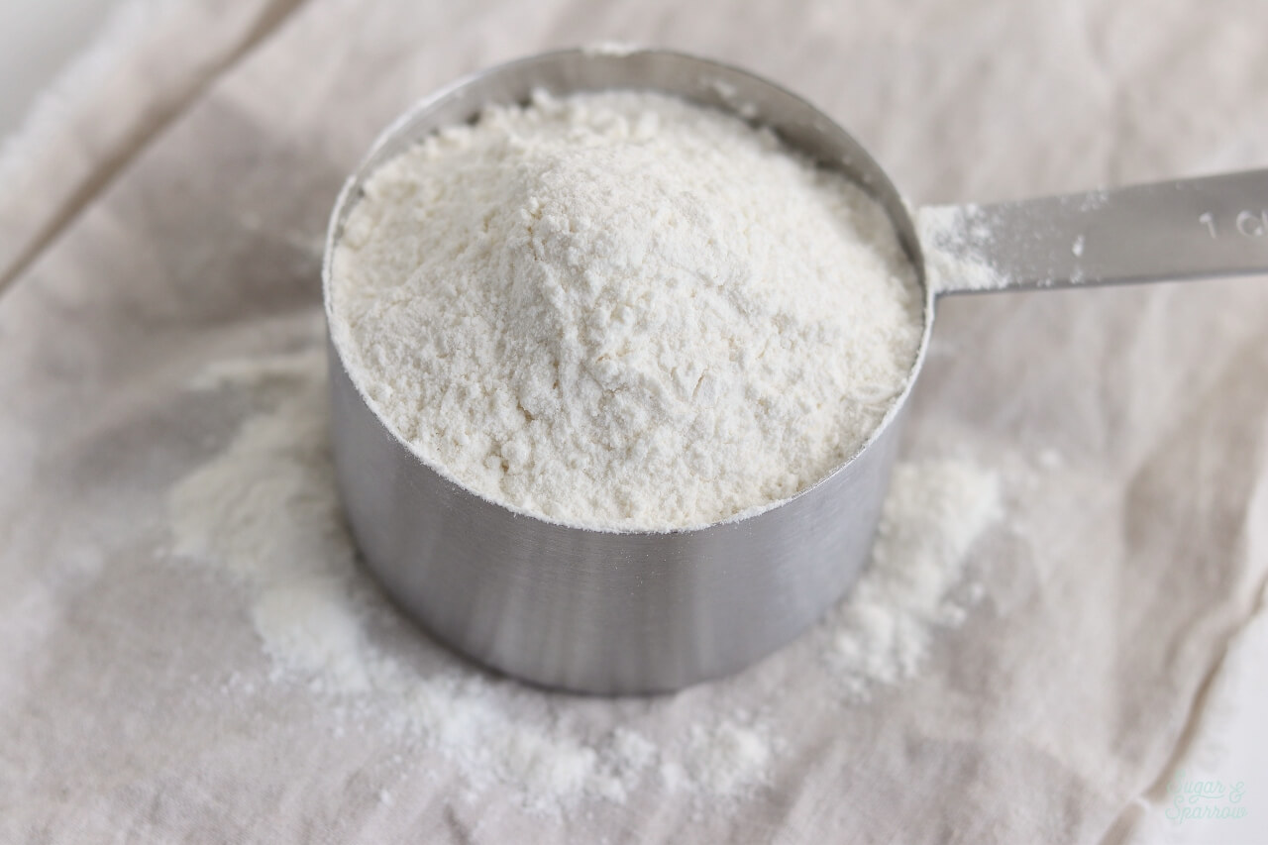
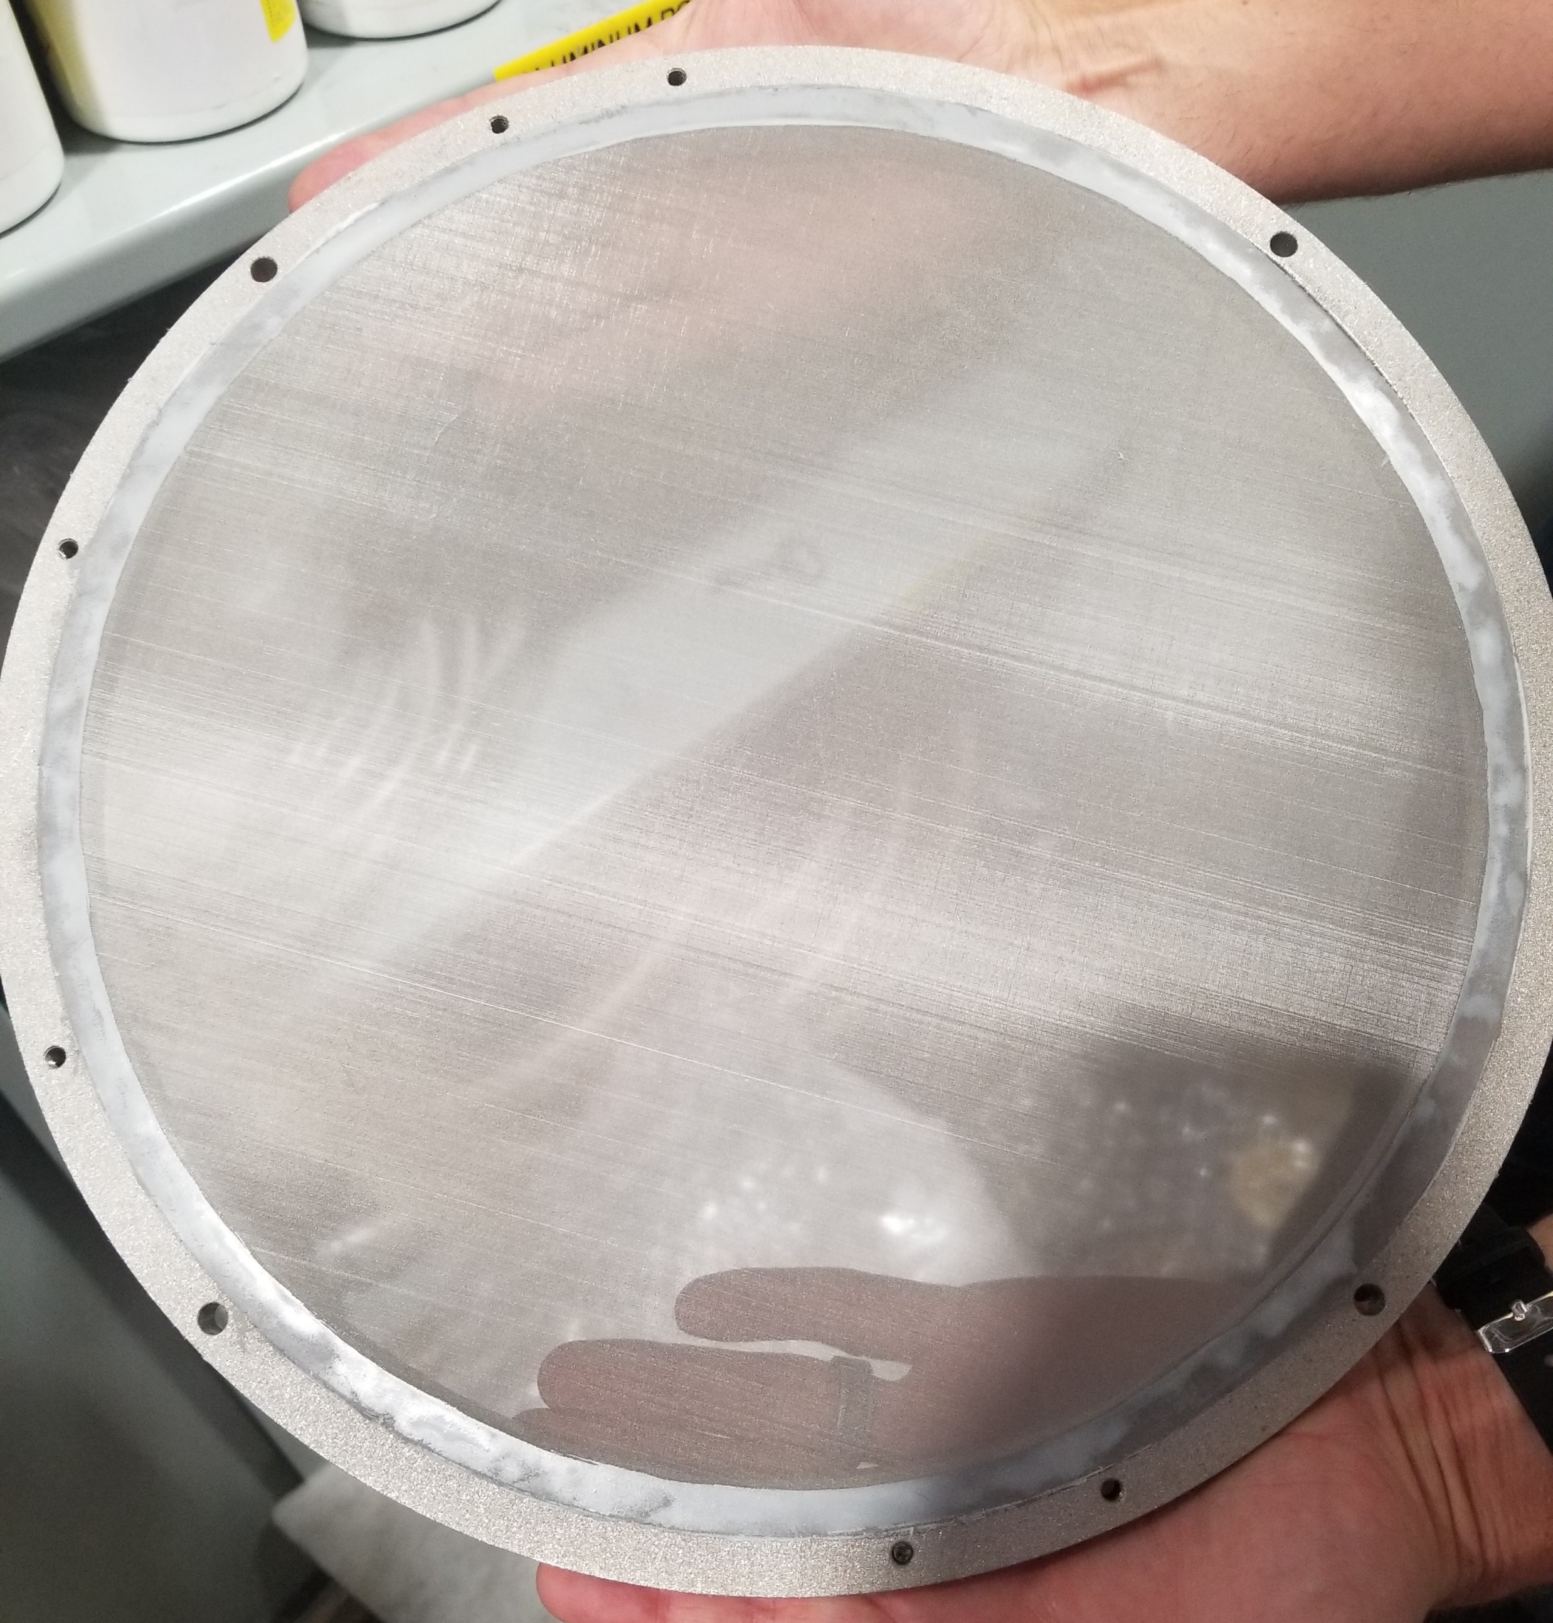
Validation Plan
Flour: 25-400 μm
75 μm Mesh
Scaled 4x
Kevin Richter

Slide 31
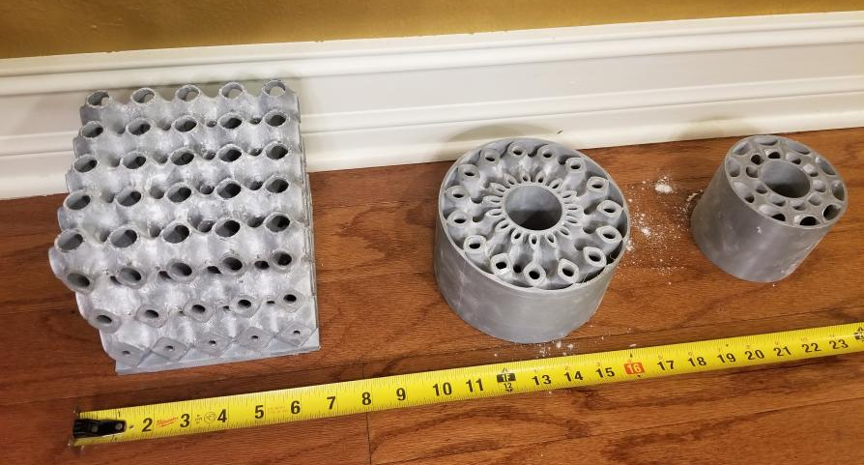
Validation Test and Results
The Three Polymer Test Prints
Arlan Ohrt

Slide 32
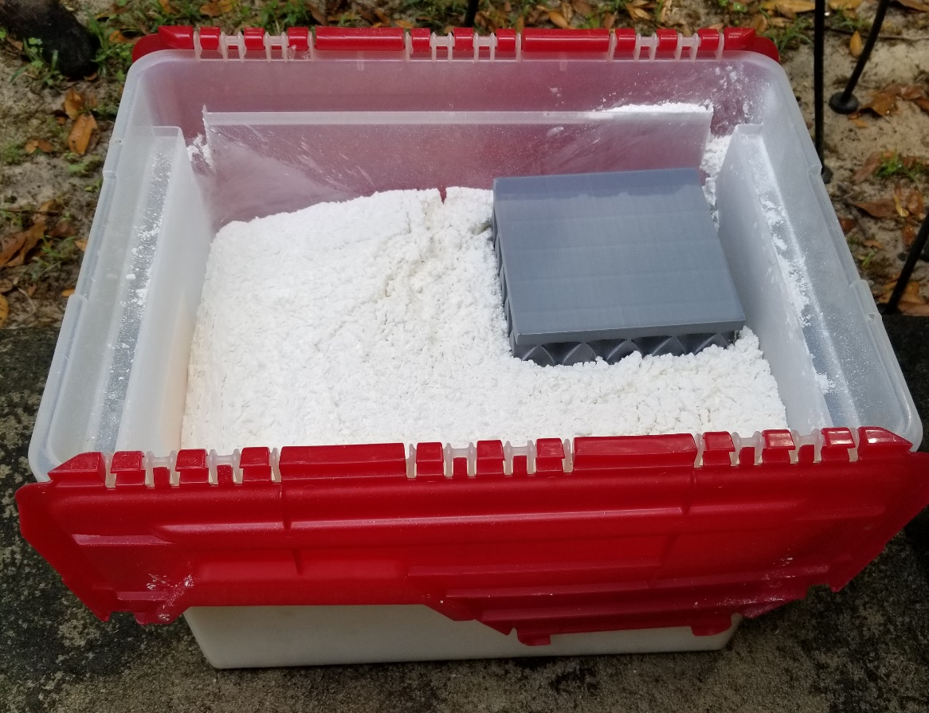
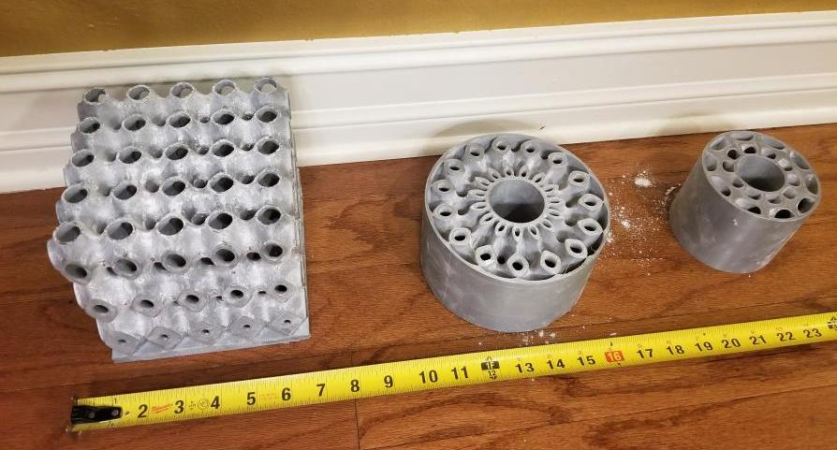
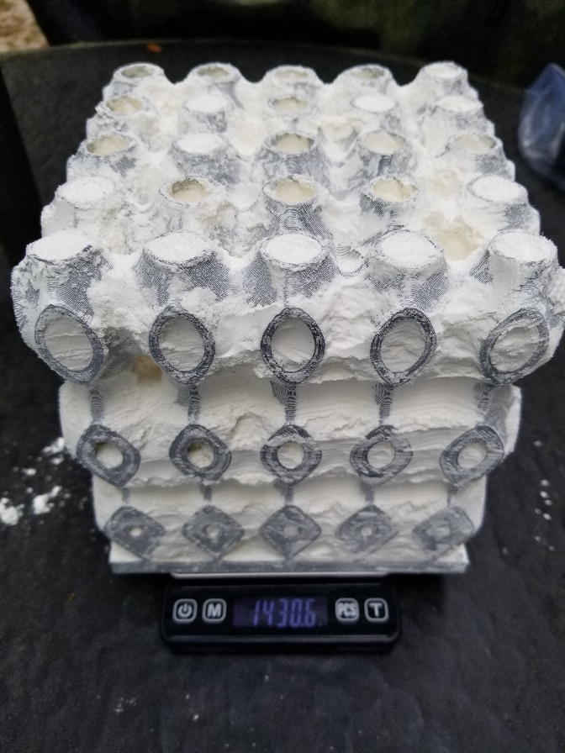
Validation
The Three Polymer Test Prints
Add Flour to Test Print
Arlan Ohrt

Slide 33
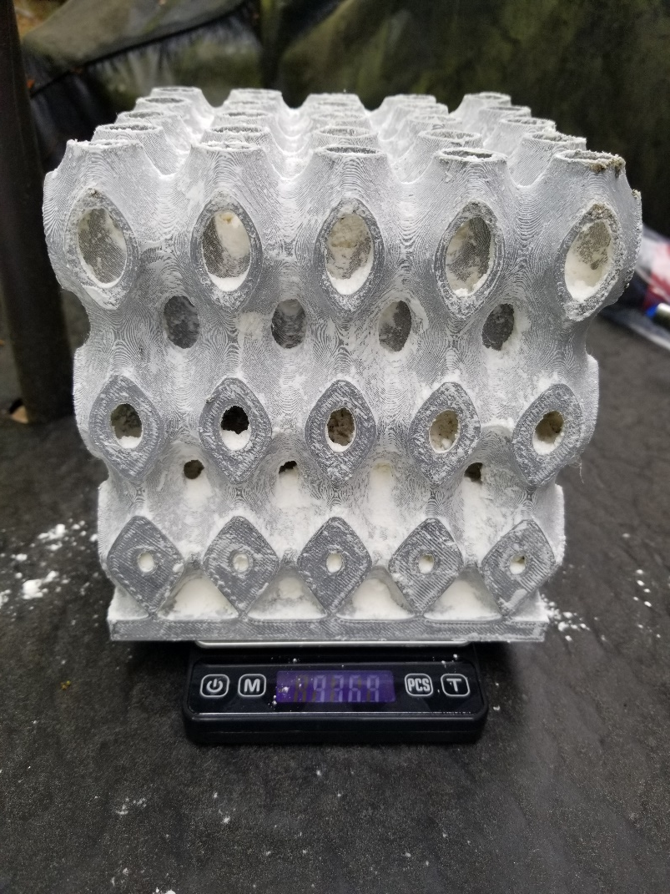
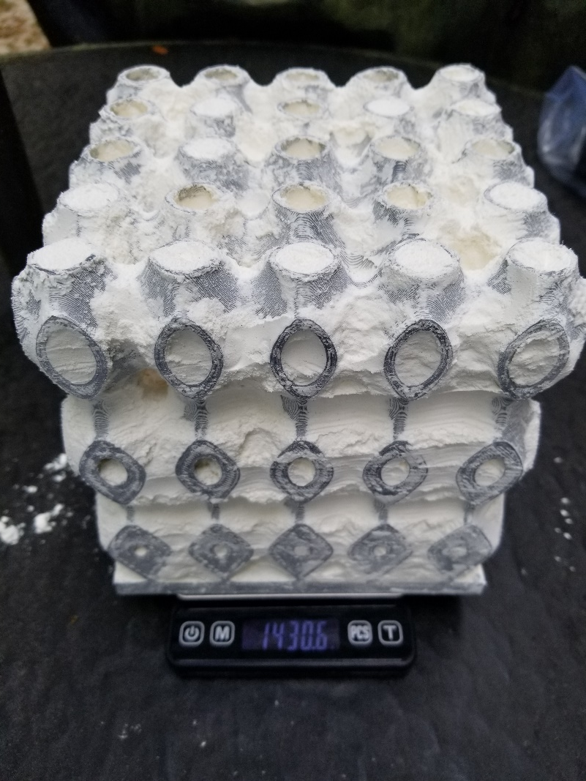
Validation
The Three Polymer Test Prints
Remove Bulk Powder
Add Flour to Test Print
Arlan Ohrt

Slide 34
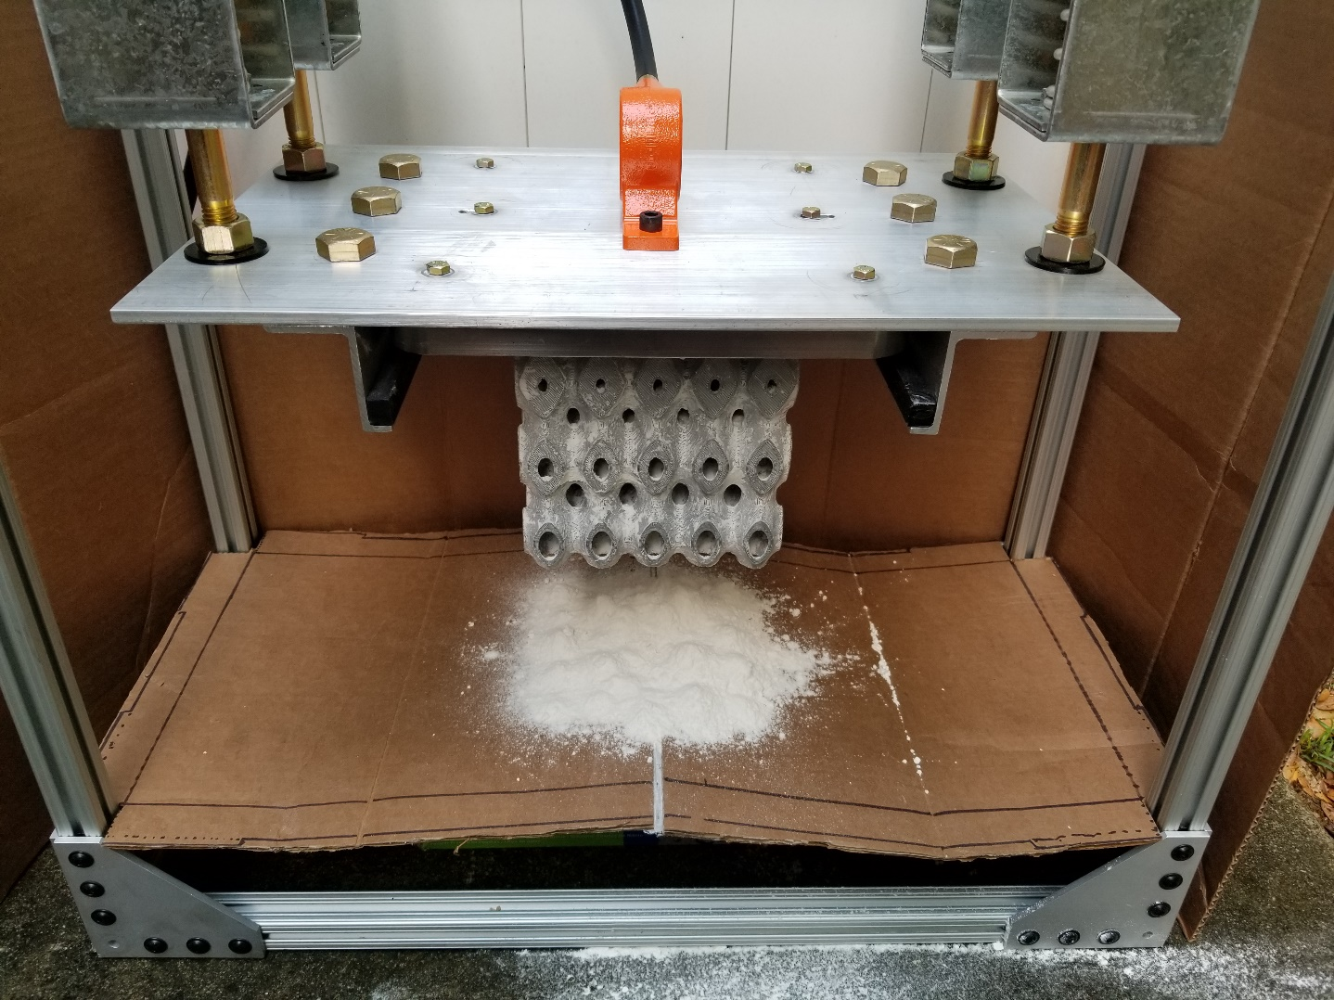
Validation
Add Flour to Test Print
Remove Bulk Powder
Adhere to Plate
Arlan Ohrt
Mount to Design
Run for 5 Minutes

Slide 35
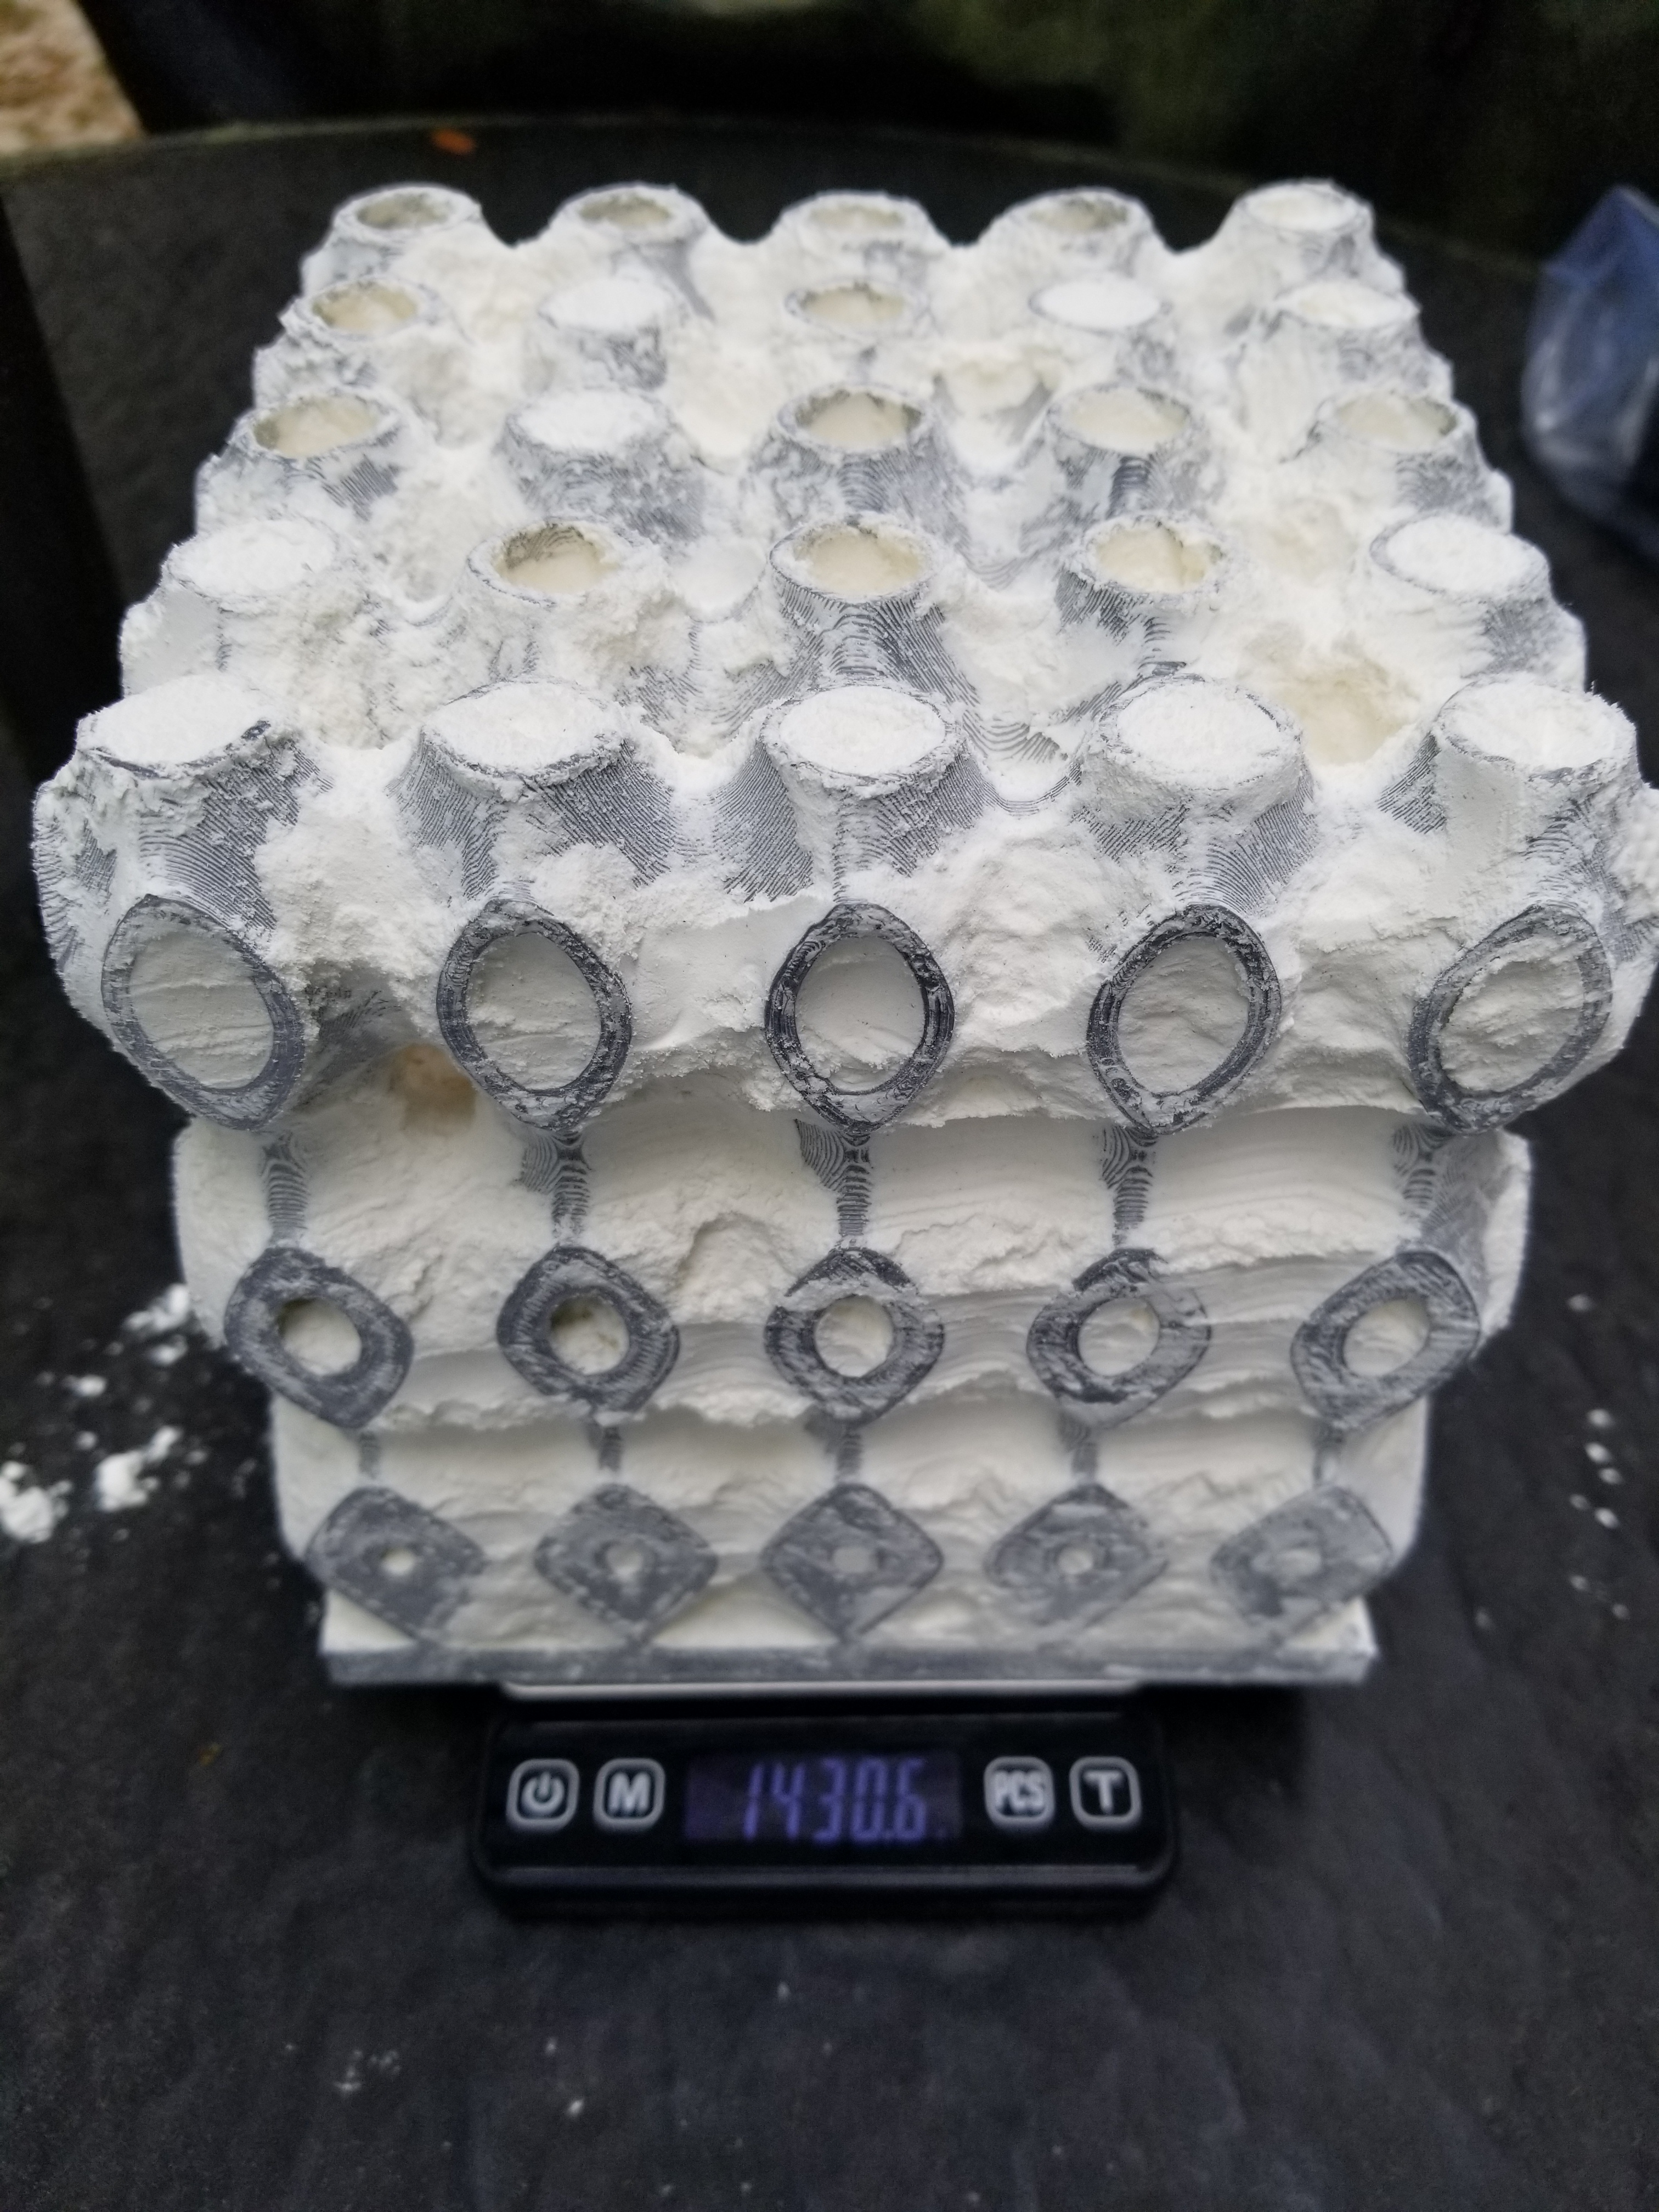
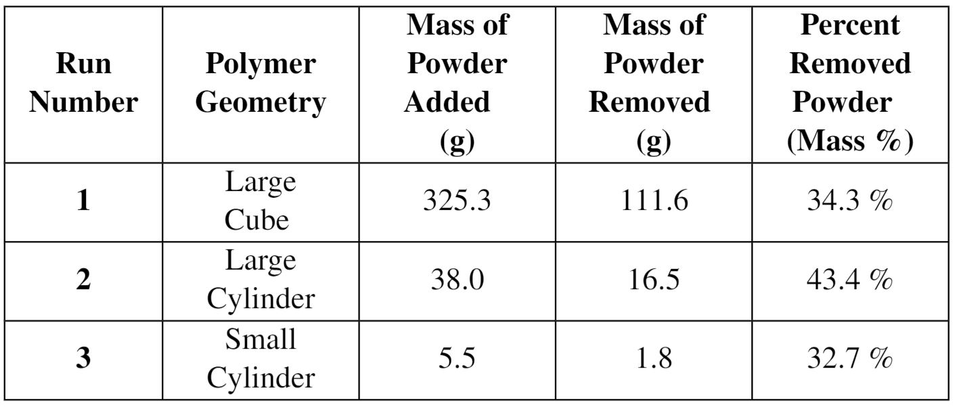
Validation
Adhere to Plate
Mount to Design
Run for 5 Minutes
Arlan Ohrt
Remove Bulk Powder
Unofficial Run 4
Ran large cube for 5 minutes, then pounded and blew air. Better results

Slide 36
Validation Results
Target Check
Greater than 0 grams of separated powder in container
Adhere to Plate
Mount to Design
Target Check
Passes through 75 μm mesh
Run for 5 Minutes
Unofficial Run 4
Ran large cube for 5 minutes, then pounded and blew air on it.
Arlan Ohrt

Slide 37
Validation Results
Target Check
Greater than 0 grams of separated powder in container
Target Check
Passes through 75 μm mesh
Arlan Ohrt

Slide 38
Project Conclusion
Separate powder from the part
Transports powder to a container
Hold the part in the area
Isolate the powder from user
Prevents powder contamination
Function
Greater than 0 grams of separated powder in container
Pass Bioenvironmental Engineering Flight (BEF) air test
Passes through 75 μm mesh
Build volume: 250 x 250 x 300 mm
Over-estimated weight: 356 N
Target
Joshua Dorfman

Slide 39
Project Results
Separate powder from the part
Transports powder to a container
Hold the part in the area
Isolate the powder from user
Prevents powder contamination
Function
Greater than 0 grams of separated powder in container
Pass Bioenvironmental Engineering Flight (BEF) air test
Passes through 75 μm mesh
Build volume: 250 x 250 x 300 mm
Over-estimated weight: 356 N
Target
Joshua Dorfman

Slide 40
Budget
Enclosure
$2,000
$4,000
$6,000
$8,000
Design
$500
$1,000
$1,500
$2,000
Joshua Dorfman

Slide 41
Budget
Enclosure
$3,500
$2,000
$4,000
$6,000
$8,000
Design
$1,100
$500
$1,000
$1,500
$2,000
Joshua Dorfman

Slide 42
Design Budget
$1,100
$345
$292
$243
$220
$500
$1,000
$1,500
$2,000
Structure
Build Plate Holder
Pneumatics
Suspension
Joshua Dorfman

Slide 43
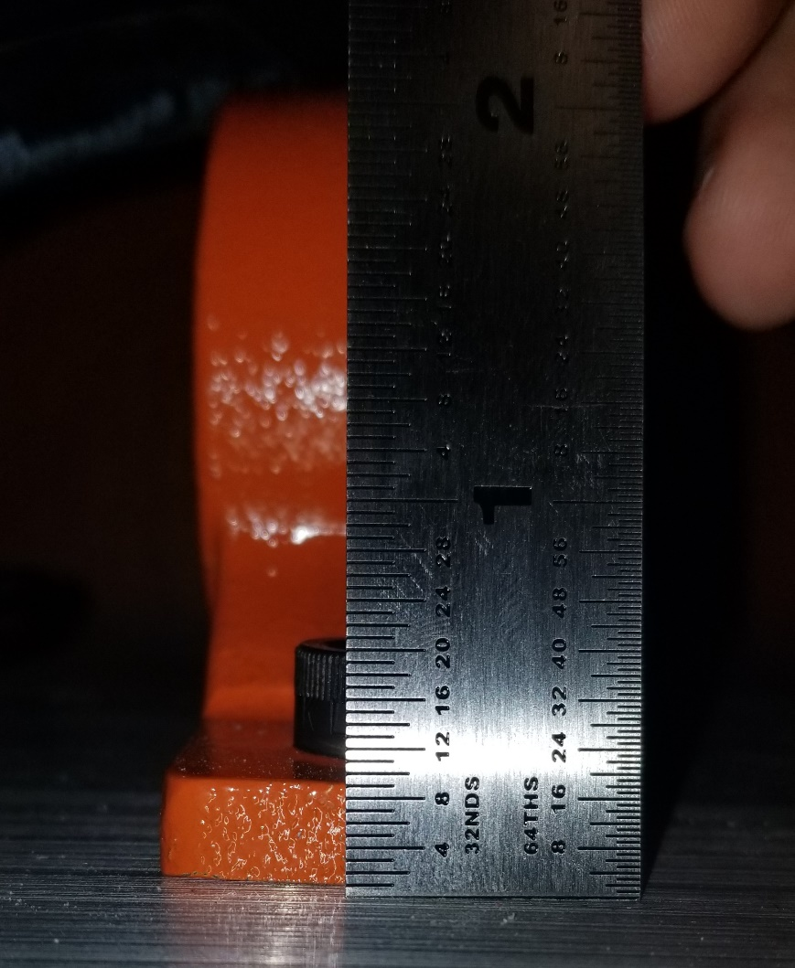
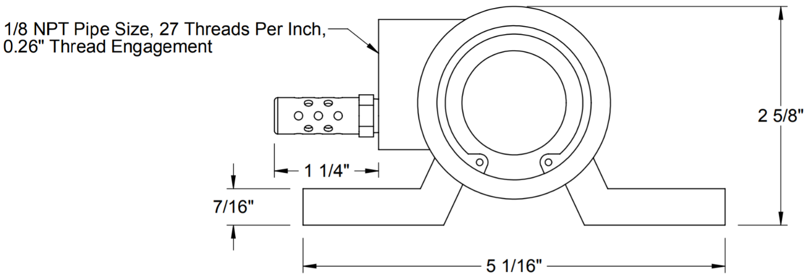
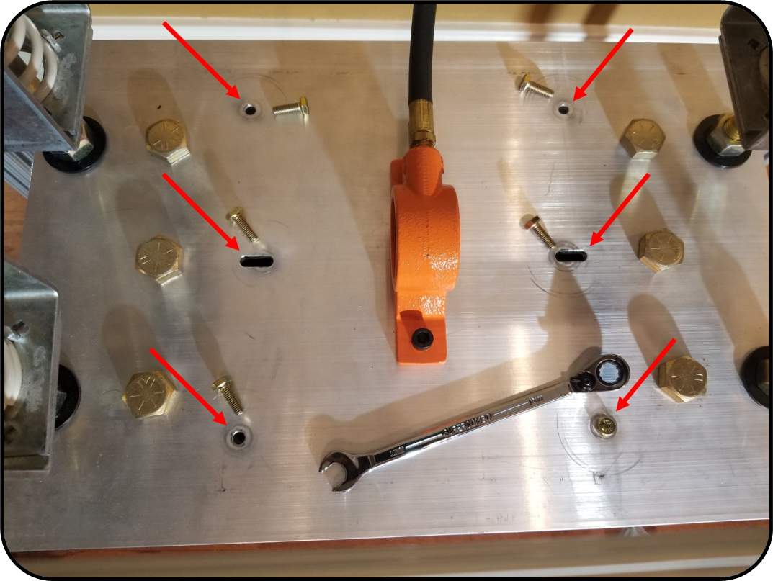
Lessons Learned
Supplier CAD and drawings may not be accurate.
Machining mistakes can happen, and it helps to communicate efficiently.
Lesson 1
Lesson 2
Holes machined in incorrect spot, slotted to correct.
7/16”
Actual Height
Joshua Dorfman

Slide 44
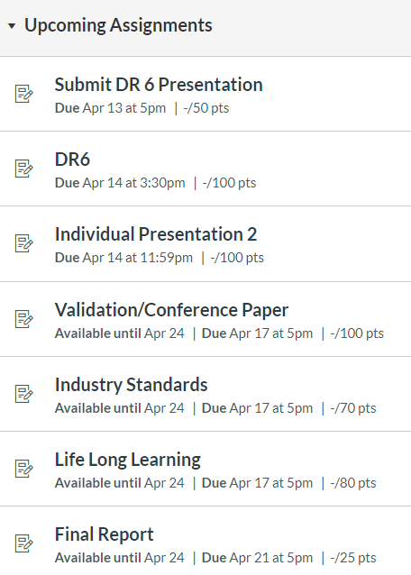
Time management, frequent communication, and clear roles benefited us greatly.
Lessons Learned
Lesson 3
Supplier CAD and drawings may not be accurate.
Machining mistakes can happen, and it helps to communicate efficiently.
Lesson 1
Lesson 2
Holes machined in incorrect spot, slotted to correct.
7/16”
Actual Height
Joshua Dorfman

Slide 45
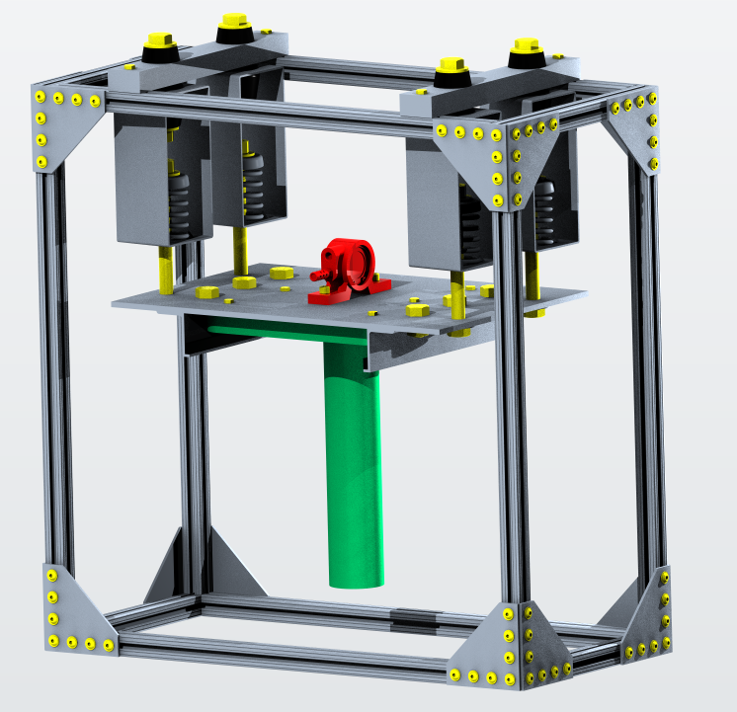
Lessons Learned
Time management, frequent communication, and clear roles benefited us greatly.
Machining mistakes can happen, and it helps to communicate efficiently.
Lesson 3
Lesson 2
Add a linear actuator to the frame that “beats” the plate like a drum to remove more.
Idea
Holes machined in incorrect spot, slotted to correct.
Add automated compressed air to blow on the plate to remove more.
Idea
Joshua Dorfman

Slide 46
Future Concepts
Time management, frequent communication, and clear roles benefited us greatly.
Lesson 3
Add a linear actuator to the frame that “beats” the plate like a drum to remove more.
Idea
Add automated compressed air to blow on the plate to remove more.
Idea
Joshua Dorfman

Slide 47
References
Title Slide Background - https://www.materialise.com/en/blog/when-how-and-where-of-metal-3d-printing
Recycle - https://www.recycling.com/wp-content/uploads/recycling%20symbols/black/Black%20Recycling%20Symbol%20%28U%2b267B%29.png
3D Systems – https://www.3dsystems.com/3d-printers/prox-dmp-300/specifications
LPBF Demo GIF - https://thescopepopculturescience.blogspot.com/2015_01_01_archive.html
Stainless Steel Properties - https://www.3dsystems.com/materials/metal
nTopology – https://ntopology.com/
PAPR – https://images-na.ssl-images-amazon.com/images/I/4125zPcBPNL.jpg
Sandblaster - https://badboyblasters.com/product/abrasive-media-sand-blaster-bb1050led-bvr-pr-hv-fl-2/
AFRL Sign - https://news.wfsu.org/post/eglin-air-force-base-ready-adjust-hiring-freeze
Electric Vibrator - https://www.mcmaster.com/5808k61
Dampeners - https://www.mcmaster.com/29895t54 , https://www.mcmaster.com/9241k44
Flour - https://sugarandsparrow.com/homemade-cake-flour-recipe/
Wind - https://icon-icons.com/icon/wind/64274

Slide 48
Team 501: Powder Recovery for Metal Additive Manufacturing
Arlan Ohrt
Kevin Richter
Vincent Giannetti
Noah Tipton
Joshua Dorfman
April 16th, 2020

Slide 49
Backup Slides
3D Systems Printer Specs
Functional Decomposition
Work Breakdown
Validation
Group Member Contact
17- 4PH Material
nTopology
Return

Slide 50
Return

Slide 51
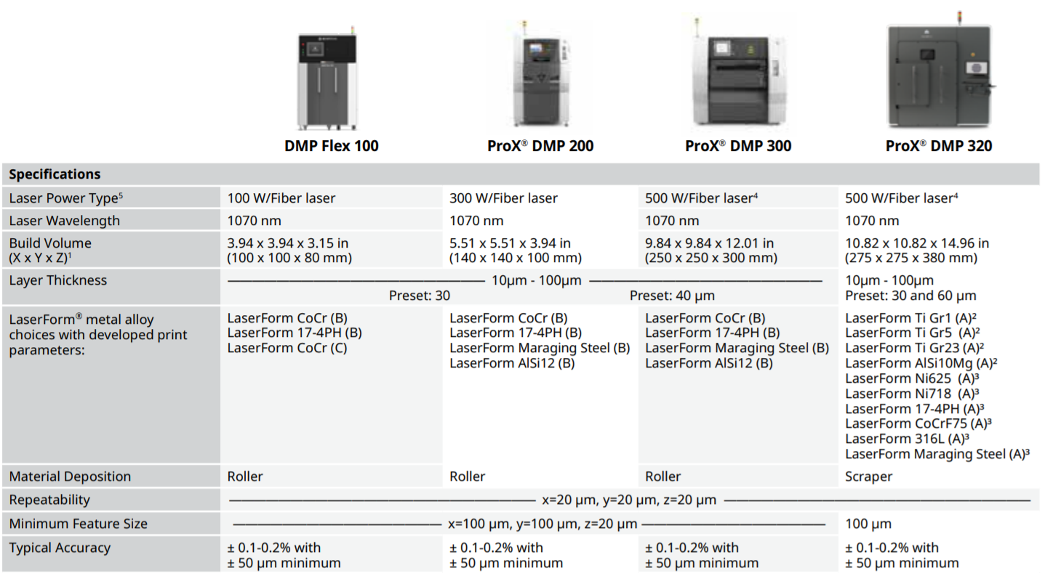
Return

Slide 52
Group Contact
Vincent Giannetti
Noah Tipton
Joshua Dorfman
Arlan Ohrt
Kevin Richter
vjg15b@my.fsu.edu
nrt15@my.fsu.edu
jd16s@my.fsu.edu
ago16b@my.fsu.edu
kr15@my.fsu.edu
Return

Slide 53
Group Work Breakdown
Team leadership and management
Validation runs
Presentations
Fiscal documentation and planning
Enclosure analysis and selection
Closing documentation
Secondary leadership and management
Hands on work
Document refinement
Design specific work
Design analysis
CAD
Team 501
Validation planning
Hands on work
Always working
Assignments led
Ideation, concept selection, functional decomp….
Grammar and content checks
Return

Slide 54
Functional Decomposition
Recover Powder
Manage Powder
Support the Part
Inhibit Powder
Separates powder from the part
Transports powder
to a container
Hold the part
in the area
Isolate the powder
from user
Prevents powder contamination
Mass
Mass
1) Volume
2) Force
Up to Eglin AFB safety standards
Particle Size
Metric
Greater than 0 grams of separated powder in container
1) 250 x 250 x 300 mm
2) 356 N
Pass Bioenvironmental Engineering Flight (BEF) air test
Passes through 75 μm mesh
Target
Return

Slide 55
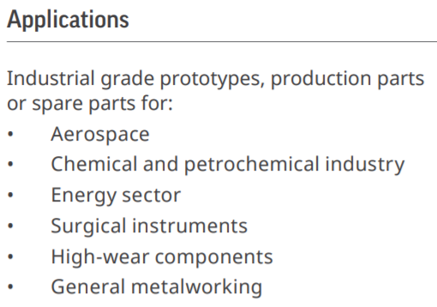
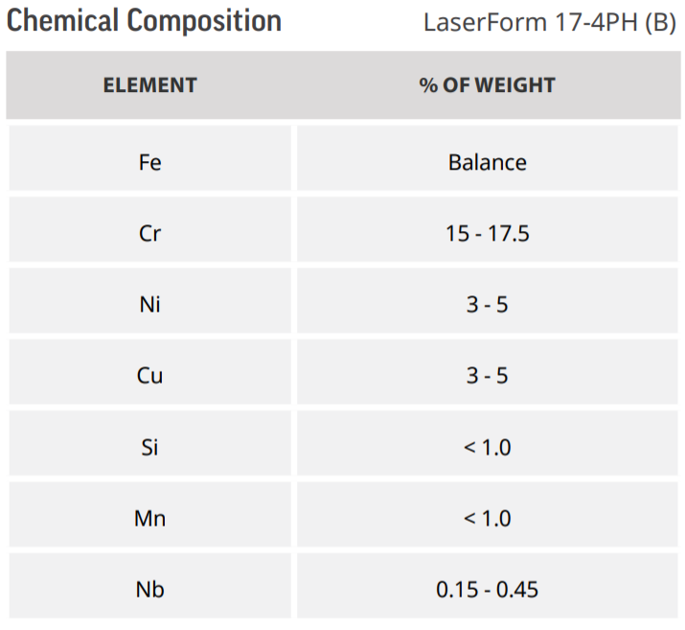
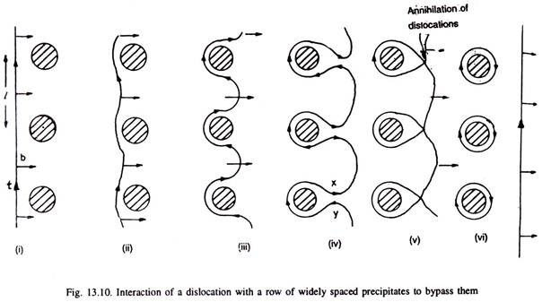
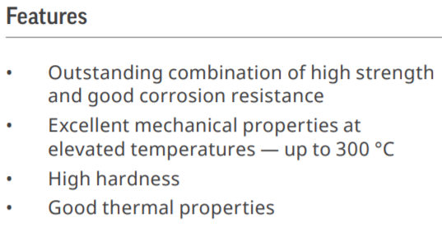
17- 4PH Stainless Steel
The strength and hardness of some materials can be increased by the formation of very small particles
This is done through heat treatments
It is called “Precipitation Hardening” because the process results in very small particles, called “Precipitates”
This works because precipitates help block dislocation motion, which is an important aspect of a materials failure and properties
https://www.3dsystems.com/sites/default/files/2017-06/3D-Systems_17-4_PH_%28B%29_DMP_DATASHEET_US_A4_2017.06.21_WEB.pdf
http://www.engineeringenotes.com/metallurgy/age-hardening-treatment/age-hardening-treatment-of-metals-metallurgy/26376
Return

Slide 56
Validation
Sources for Inconsistencies
Powder and test print size
Underpowered compressor used
Polymer test print surface properties
Flour’s properties other than size
Performed in a backyard with a carboard barrier
 |  | Measured Masses (grams)
 |  | Build Plate | Polymer Test Print | Polymer Test Print + Bulk Powder | Polymer Test Print + Powder Film | Adhesive Used | Polymer Test Print + Powder Film + Adhesive + Build Plate (Before Run) | Powder Catching Platform (Before Run) | Powder Catching Platform + Removed Powder | Polymer Test Print + Powder Film + Adhesive + Build Plate (After Run) | Polymer Test Print + Remaining Powder + Dried Abrasive Residue
 |  | M1 | M2 | M3 | M4 | M5 | M6 | M7 | M8 | M9 | M10
Test Runs | Square Polymer Test Print | 11,340.0 | 611.6 | 1,430.6 | 936.9 | 4.0 | 12,247.0 | 151.5 | 263.1 | 12,247.0 | 752.4
 | Large Cylinder Test Print | x | 402.1 | 815.9 | 440.1 | 5.1 | x | 153.9 | 170.4 | x | 416.1
 | Small Cylinder Test Print | x | 201.4 | 322.0 | 206.9 | 3.9 | x | 152.1 | 153.9 | x | 208.3
Return

Slide 57
Arlan Ohrt

Slide 58
Standard Shapes
Summary Box
Text box 1
Outlined Text Box

Slide 59
Approved Logos

Slide 60
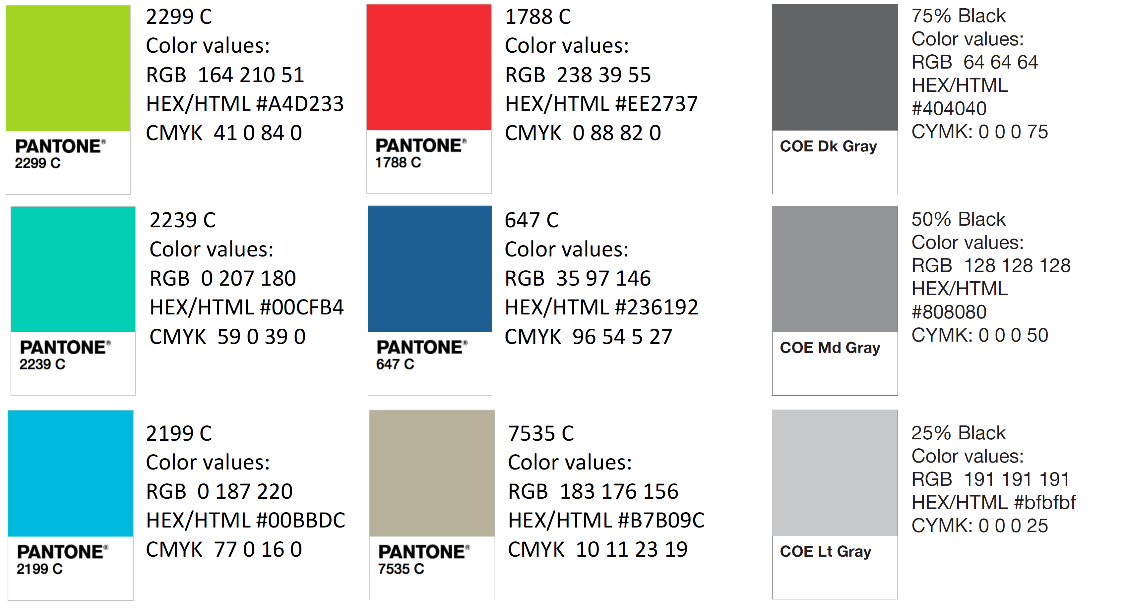
Color Palette

Slide 61
APA Tables
Category 1 | Category 2 | Category 3 | Category 4 | Category 5
Item 1
Item 2
Item 3
Item 4
 | Category 2 |  |  | Category 3
Category 1 | subcategory 1 | subcategory 2 |  | subcategory 1 | subcategory 2
Item 1
Item 2
Item 3
Item 4

